Slide 1
Who Are American Muslims?
Notes:
Today the challenges are many. From the protection of rights, to the building of bridges between communities, to community development, it can be a bit overwhelming to know where to start.
ISPU, alongside a whole network of committed organizations and people, is here working for you. And we have a unique niche and platform. I am excited to share our work with you today.
I am going to start with some scenarios and get you thinking about what all these scenarios might have in common:
A mosque in Michigan is trying to get zoning permission and having terrible trouble. While they have engaged a lawyer, they are seeking concrete tools to help them best prepare and ultimately win their hearings.
A journalist is planning on writing a series for the New York Times about Muslim life in America and wants to decide what issues to focus on and how to cover them.
A Senator is introducing and reintroducing a Religious Freedom Bill to bar discrimination against Muslims coming to the US and he needs some data and information to help convince others to pass this bill.
A mosque in Cedar Rapids wants to better serve their congregants, becoming more inclusive, engaging young people and providing needed services, but needs guidance on how.
A group of Muslim leaders is writing a letter to then President-Elect Trump and want to use reliable data points.
An advocate is meeting with their State elected official and before heading to the meeting, wants to know where the official stands on certain issue areas including anti-Muslim measures.
The American Federation of Teachers was trying to address anti-Muslim incidents, rhetoric and bullying in schools and needed data and stories.
What they all have in common is ……….
They came to us. They used our research. They used our data. They used our case studies, and tools, and resources. They used us as a go-to expert on American Muslims and a reliable source of information to help them in their own important work.
And this is the crux of what we do. Through our research and the sharing of that research, we POWER the work of so many important efforts.
Our research provides data points to back up arguments or quantify a problem.
Our research highlights case studies of successful models that can be adapted.
Our research provides analysis to inform decisions or actions.
Ultimately our research helps others do what they do smarter and more effectively.
We are:
proactive, rather than reactive
Lay a foundation to address root causes of problems, rather than putting a bandaid on symptoms of problems
Collaborative, not duplicative

Slide 2
A Little About Me
Notes:
Before you can speak to the audience about the facts, you need to tell them who YOU are. Personal narratives:
Give them a very short intro to who you are, making human connections: “I’m a coffee lover, a mother, an introvert. I was born in xyz and grew up in abc… ”
Tell them why you care so much about this topic with a (very short) story
If you are here then you care too so let’s start an important conversation…

Slide 3
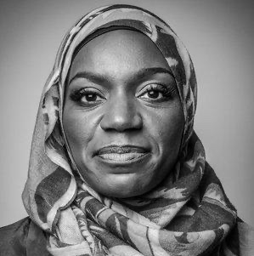
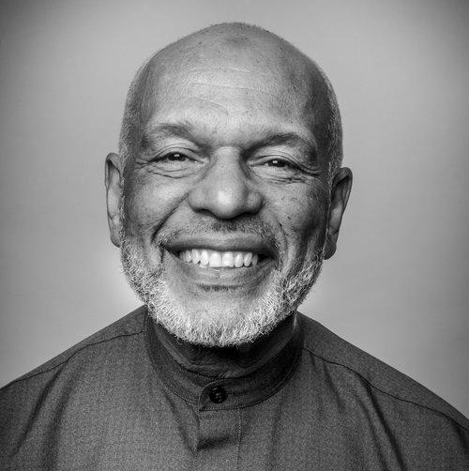
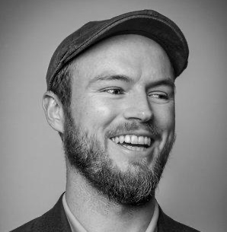
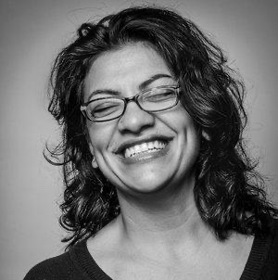
Who Are American Muslims?
Notes:
Who are American Muslims?
American Muslims are entrepreneurs and artists, rich and poor, public servants and private bankers, they are young and old, and represent every race in America.
Muslims make up roughly 1% of the total population, but are among the most discussed groups in the US, and yet perhaps the least understood.

Slide 4
About ISPU
Notes:
Before jumping into the facts, let’s look at the organization that produced this work. The Institute for Social Policy and Understanding, ISPU, is a non-partisan, non-profit research and education organization focused on the American Muslim community. Founded in 2002, ISPU conducts and share relevant rigorous research and put it in the hands of the media, policy makers, community leaders and the public, providing an evidence-based understanding of American Muslims and the issues that impact upon them.

Slide 5
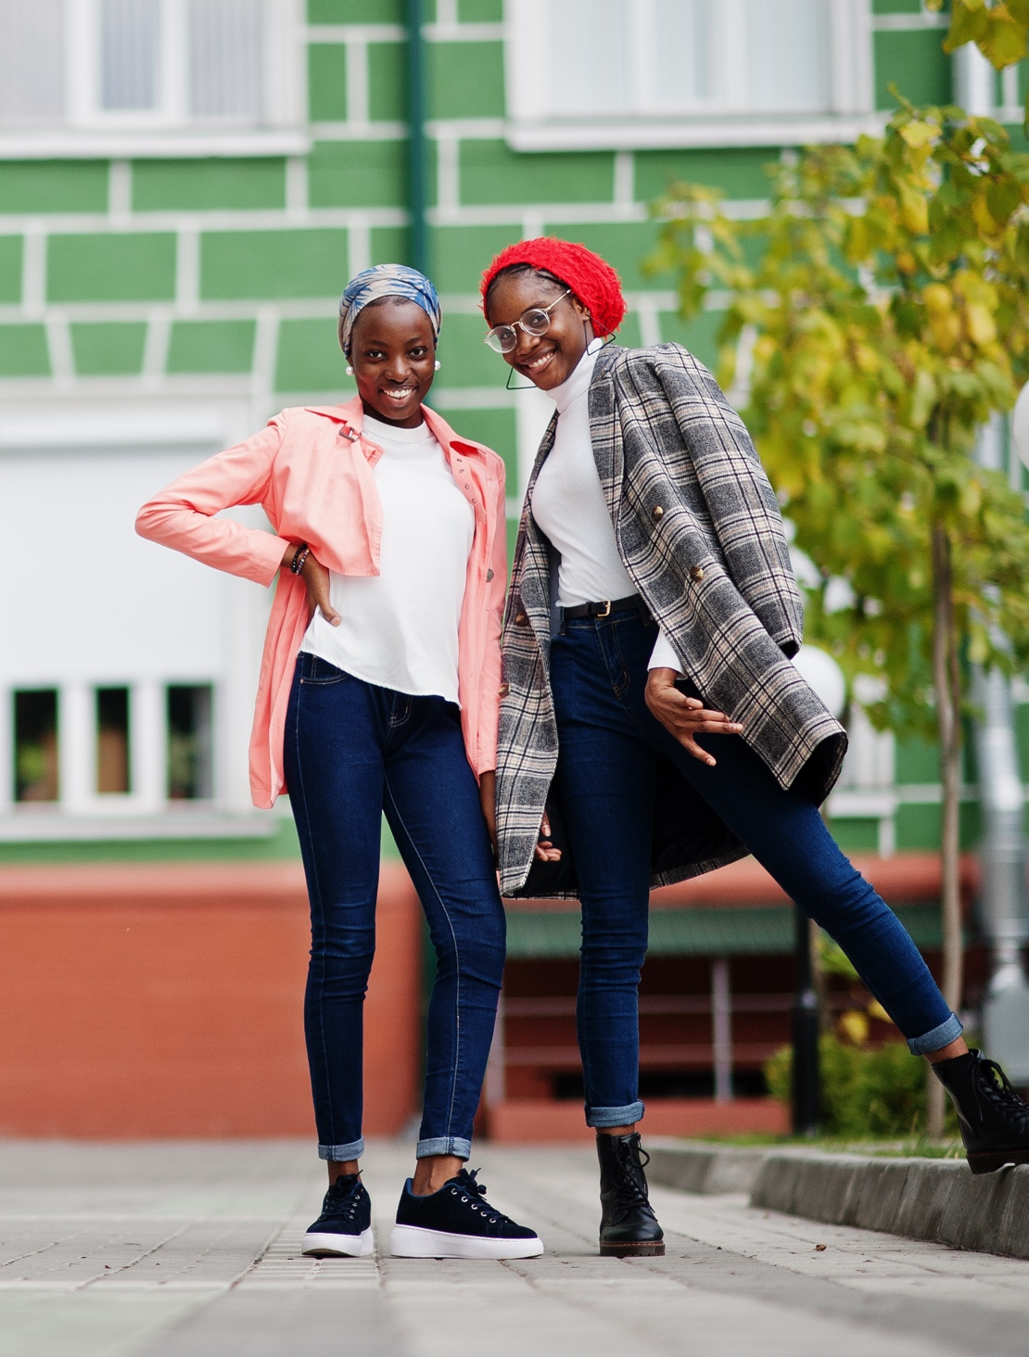
Institute for Social Policy and Understanding
Research and education to:
Build understanding
Strengthen communities
www.ispu.org
Notes:
At ISPU, we envision a vibrant and truly pluralistic America where Muslims are strong and equal participants. We work towards this vision by: first, conducting original research to discover new data, next, we use what we learn to educate the general public and raise awareness through in-person and digital education events. Finally, we provide resources and toolkits for journalists, policymakers, community leaders, and other changemakers to use in their own work.
ISPU empowers our communities and all those working towards full and equitable inclusion of Muslims in America to stand up, to speak up and to thrive.

Slide 6
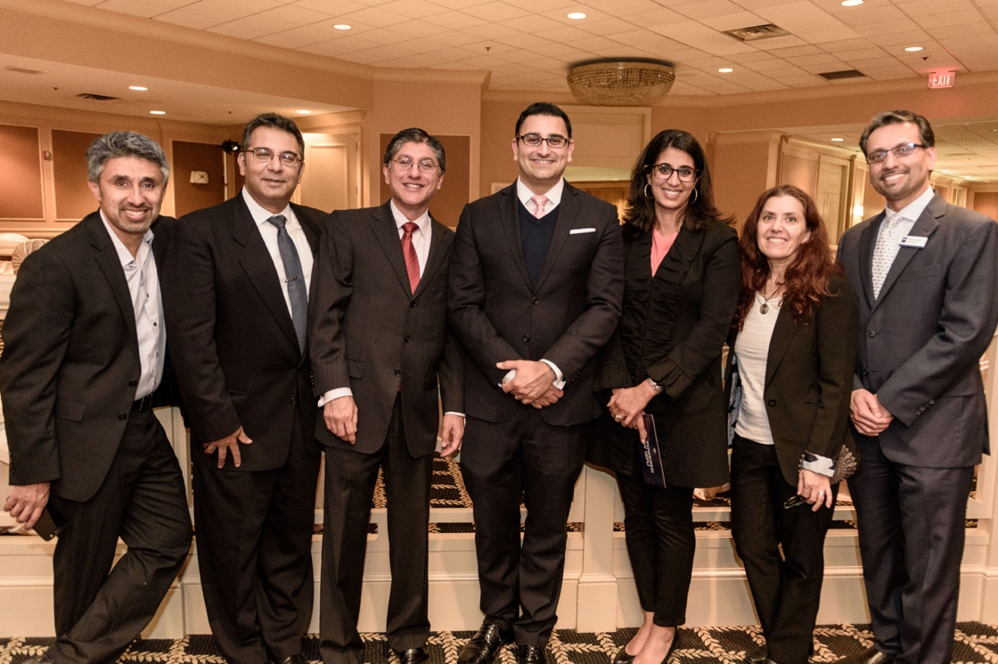
Our History
Founded in 2002
2 offices in Washington, DC, and Dearborn, MI
9 staff members
50+ affiliated academic scholars with wide-ranging expertise
Non-partisan nonprofit
Notes:
At ISPU, we envision a vibrant and truly pluralistic America where Muslims are strong and equal participants. We work towards this vision by: first, conducting original research to discover new data, next, we use what we learn to educate the general public and raise awareness through in-person and digital education events. Finally, we provide resources and toolkits for journalists, policymakers, community leaders, and other changemakers to use in their own work.
ISPU empowers our communities and all those working towards full and equitable inclusion of Muslims in America to stand up, to speak up and to thrive.

Slide 7

Why Learn the Facts?
Roughly half of Americans do not know a (real) Muslim
90% of coverage is negative
The New York Times portrays Islam more negatively than cancer and cocaine.
Sources: MediaTenor (2015) and 416Labs (Study of the past 25 years)
Notes:
Why is it important to learn the facts?
Because most Americans don’t know a real Muslim and therefore must rely on the media for information. According to a study by Media Tenor, a media content analysis firm based in Germany, 90% of US TV news media portrays Islam and Muslims negatively. As a point of comparison, North Korea, a nation that has openly threatened to bomb our country, receives coverage that is 73% negative, less negative than a diverse religious community of 1.7 billion people, of which the vast majority are US Allies.
And it’s not just the cable networks, nor a function of the horrific acts of 9/11. A study conducted by 416Labs showed that over 25 years, i.e. before 9/11, The New York Times portrayed Islam and Muslims more negatively than cancer and cocaine.

Slide 8
Reliance on media for information about Muslims was associated with Americans’ support for public policies targeting Muslims three months later. These policies included military action against Muslim countries, separate and more thorough airport security lines for Muslim travelers, and revoking the right to vote for American Muslims.
Reliance on Direct and Mediated Contact and Public Policies Supporting Outgroup Harm (2016), Muniba Saleem, Grace S. Yang, Srividya Ramasubramanian
Notes:
And what the media shows us really matters. We also know that relying on media for information about Muslims is linked to support for policies that contradict our values and our interests.
“According to a recent University of Michigan study…(read slide)”
Knowing the facts strengthens our democracy and helps us make informed decisions as citizens. This presentation seeks to paint a data-driven picture of this diverse community.

Slide 9
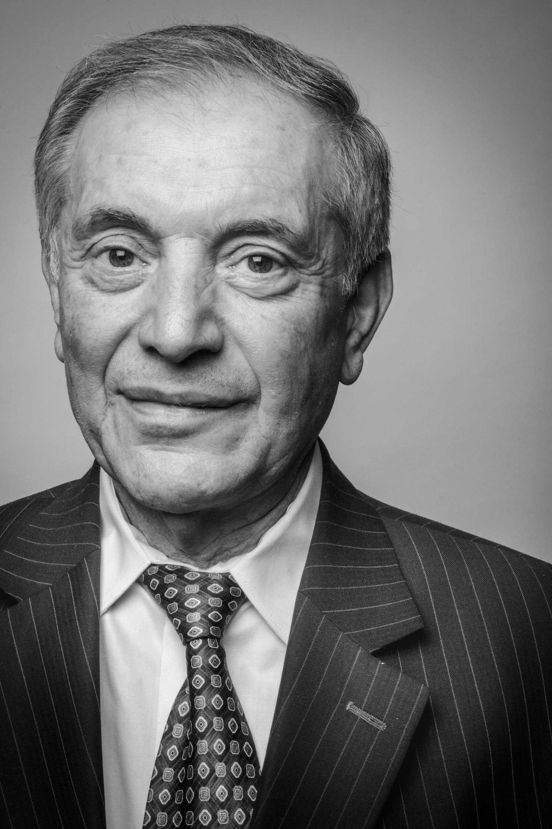

Yahya Basha
Notes:
I would like to introduce you to Dr. Yahya Basha, who is the president and founder of BASHA DIAGNOSTICS PC; he is a radiologist, businessman, and champion for refugees. He has worked with the Clinton, Bush, and Obama administrations.
Dr. Basha moved to Michigan in the 1970s to get his medical degree. After he completed his degree in Radiology and entered the job market, he found that he could not find one. Dr. Basha was facing employment discrimination. He didn’t know what to do so he turned to his Jewish colleagues for advice who had gone through similar challenges. His colleagues advised him to open up his own practice. People thought he was crazy to do so, because at the time there weren’t any independent radiology clinics but he went ahead with it. He had a really innovative idea. Instead of having patients come to his clinic, he would load up his radiology equipment into a fleet of vehicles and take it to individual practices. This was innovative because this way doctors could get the results of their patients radiology labs right away instead of waiting days or sometimes even weeks for results from hospitals. Almost right away, copycat businesses srang up and soon the hospitals were asking Dr. Basha for advice.
Dr. Basha is still known for cutting edge techniques including the open MRI machine. Dr. Basha also keeps his clinics open on weeknights and weekends to better serve Michigan patients. Dr. Basha’s story is not interesting because of his ingenuity but rather because it echoes the pattern we noticed across all our interviews of medical professionals across the state, who strive to provide excellent care to their patients.

Slide 10
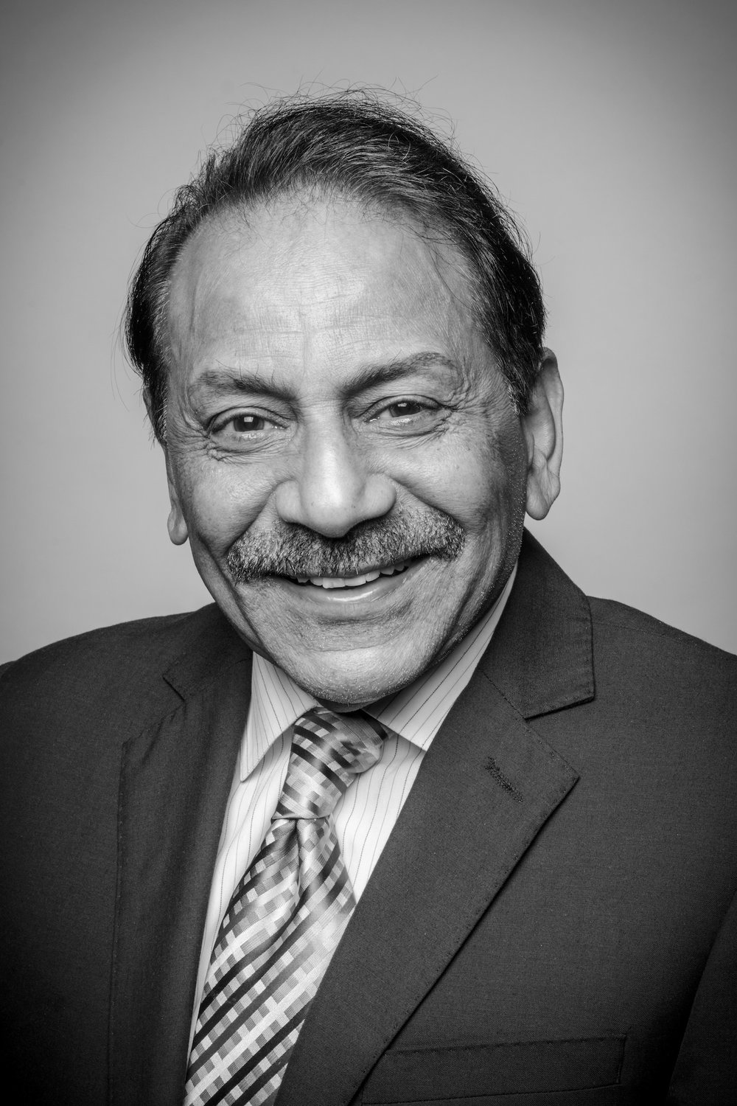
Mahmood Hai
Notes:
I would like to introduce you to Doctor Mahmood Hai, who is one of the nation’s leaders in the developing greenlight laser technology. Greenlight laser technology is an innovative treatment option for individuals suffering from enlarged prostate glands that is less painful and less invasive for patients than traditional methods. Dr. Hai led the team that performed the original FDA clinical trials in collaboration with the Mayo Clinic to become the first in the country to use the high-powered Greenlight laser in surgery. To date, his innovative technique has been used on 1 million patients nationwide.

Slide 11
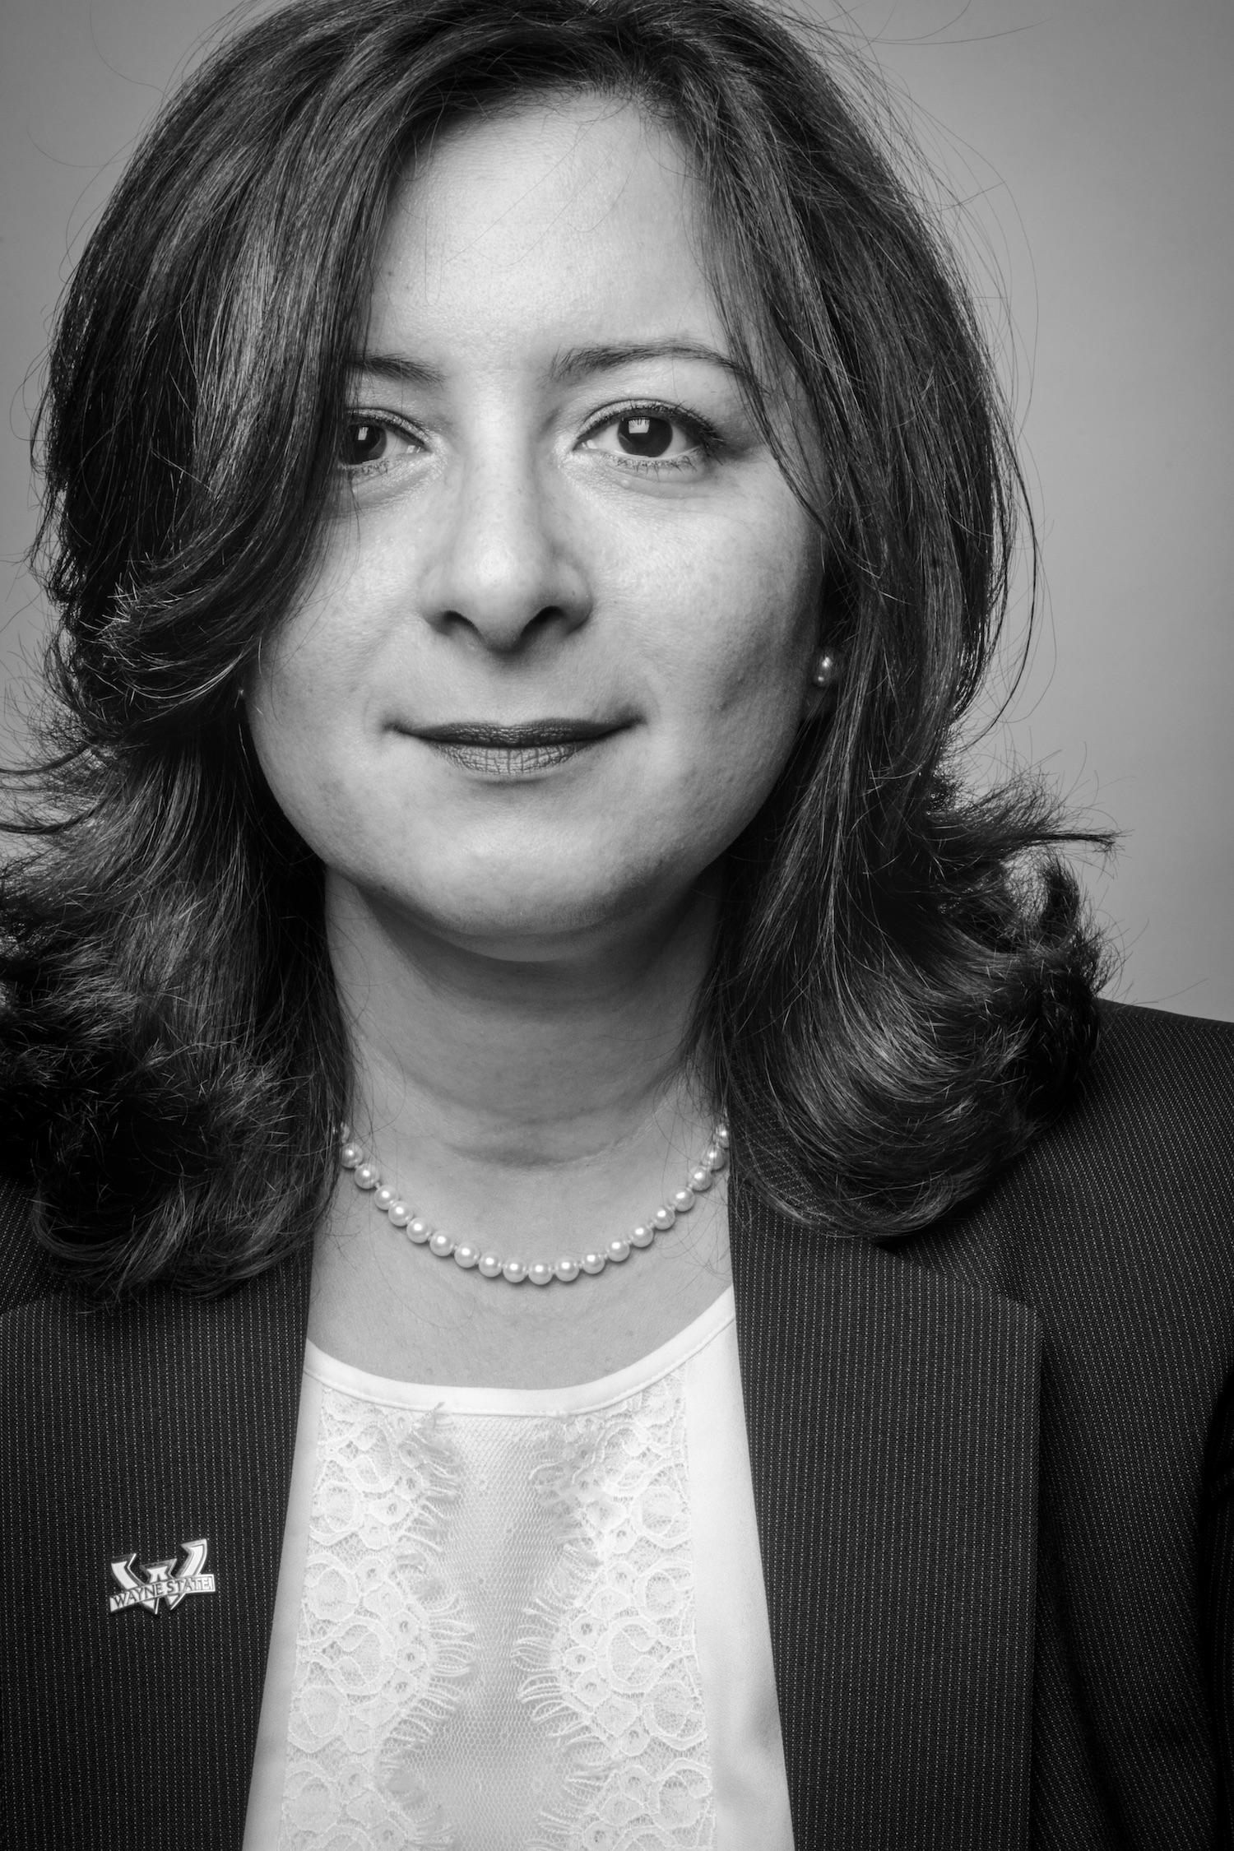
Juman Doleh Alomary
Notes:
I’d also like to introduce you to Juman Doleh Alomary. Juman is someone we refer to as a “Renaissance Muslim” because her contributions cannot neatly be filed under any one category. She is a cyber security specialist at Wayne State University. But that is not all that she does. She is also the founder of the Arab American Women’s Business Council where she promotes entrepreneurship among women in Southeastern Michigan. Perhaps what is most unique about Juman is that, in addition to her work in cyber security and her community involvement, she was also appointed to the Michigan Underground Storage Authority Board by Governor Rick Snyder. This is a very important job that most people are likely unfamiliar with. Across the state of Michigan, there are multiple underground sites that hold contaminated industrial waste. It is crucial that these underground storages stay up to spec or they will leak hazardous material into our soil and water. Juman is tasked with visiting these storage sites to make sure they are secure and doing what they need to do. If not, she is in charge of over $40 million in remediation funds to help clean up. This was a job that our researchers never even thought about before they began interviewing American Muslims. As they conducted this study, they realized that Muslims fulfill roles that they never even thought of, and they smash stereotypes along the way.

Slide 12
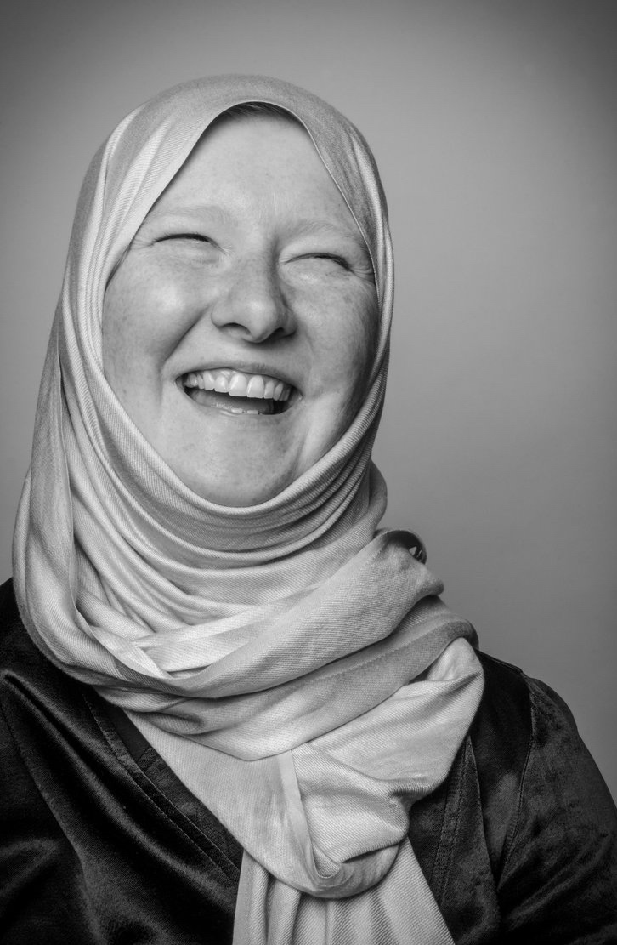
Lisa Gandy
Notes:
Meet Lisa Gandy.
She is a professor of Computer Science at Central Michigan University where she specializes in natural language processing. Lisa is remarkable not only because she is the only woman in her department, but because she created numerous camps and programs for young girls to get them interested in STEM.
She is also the chair of the university’s Women in Technology club.These initiatives are so important because less than a quarter of all STEM professions are held by women. People like Lisa are stepping up to create gender parity across STEM fields.

Slide 13
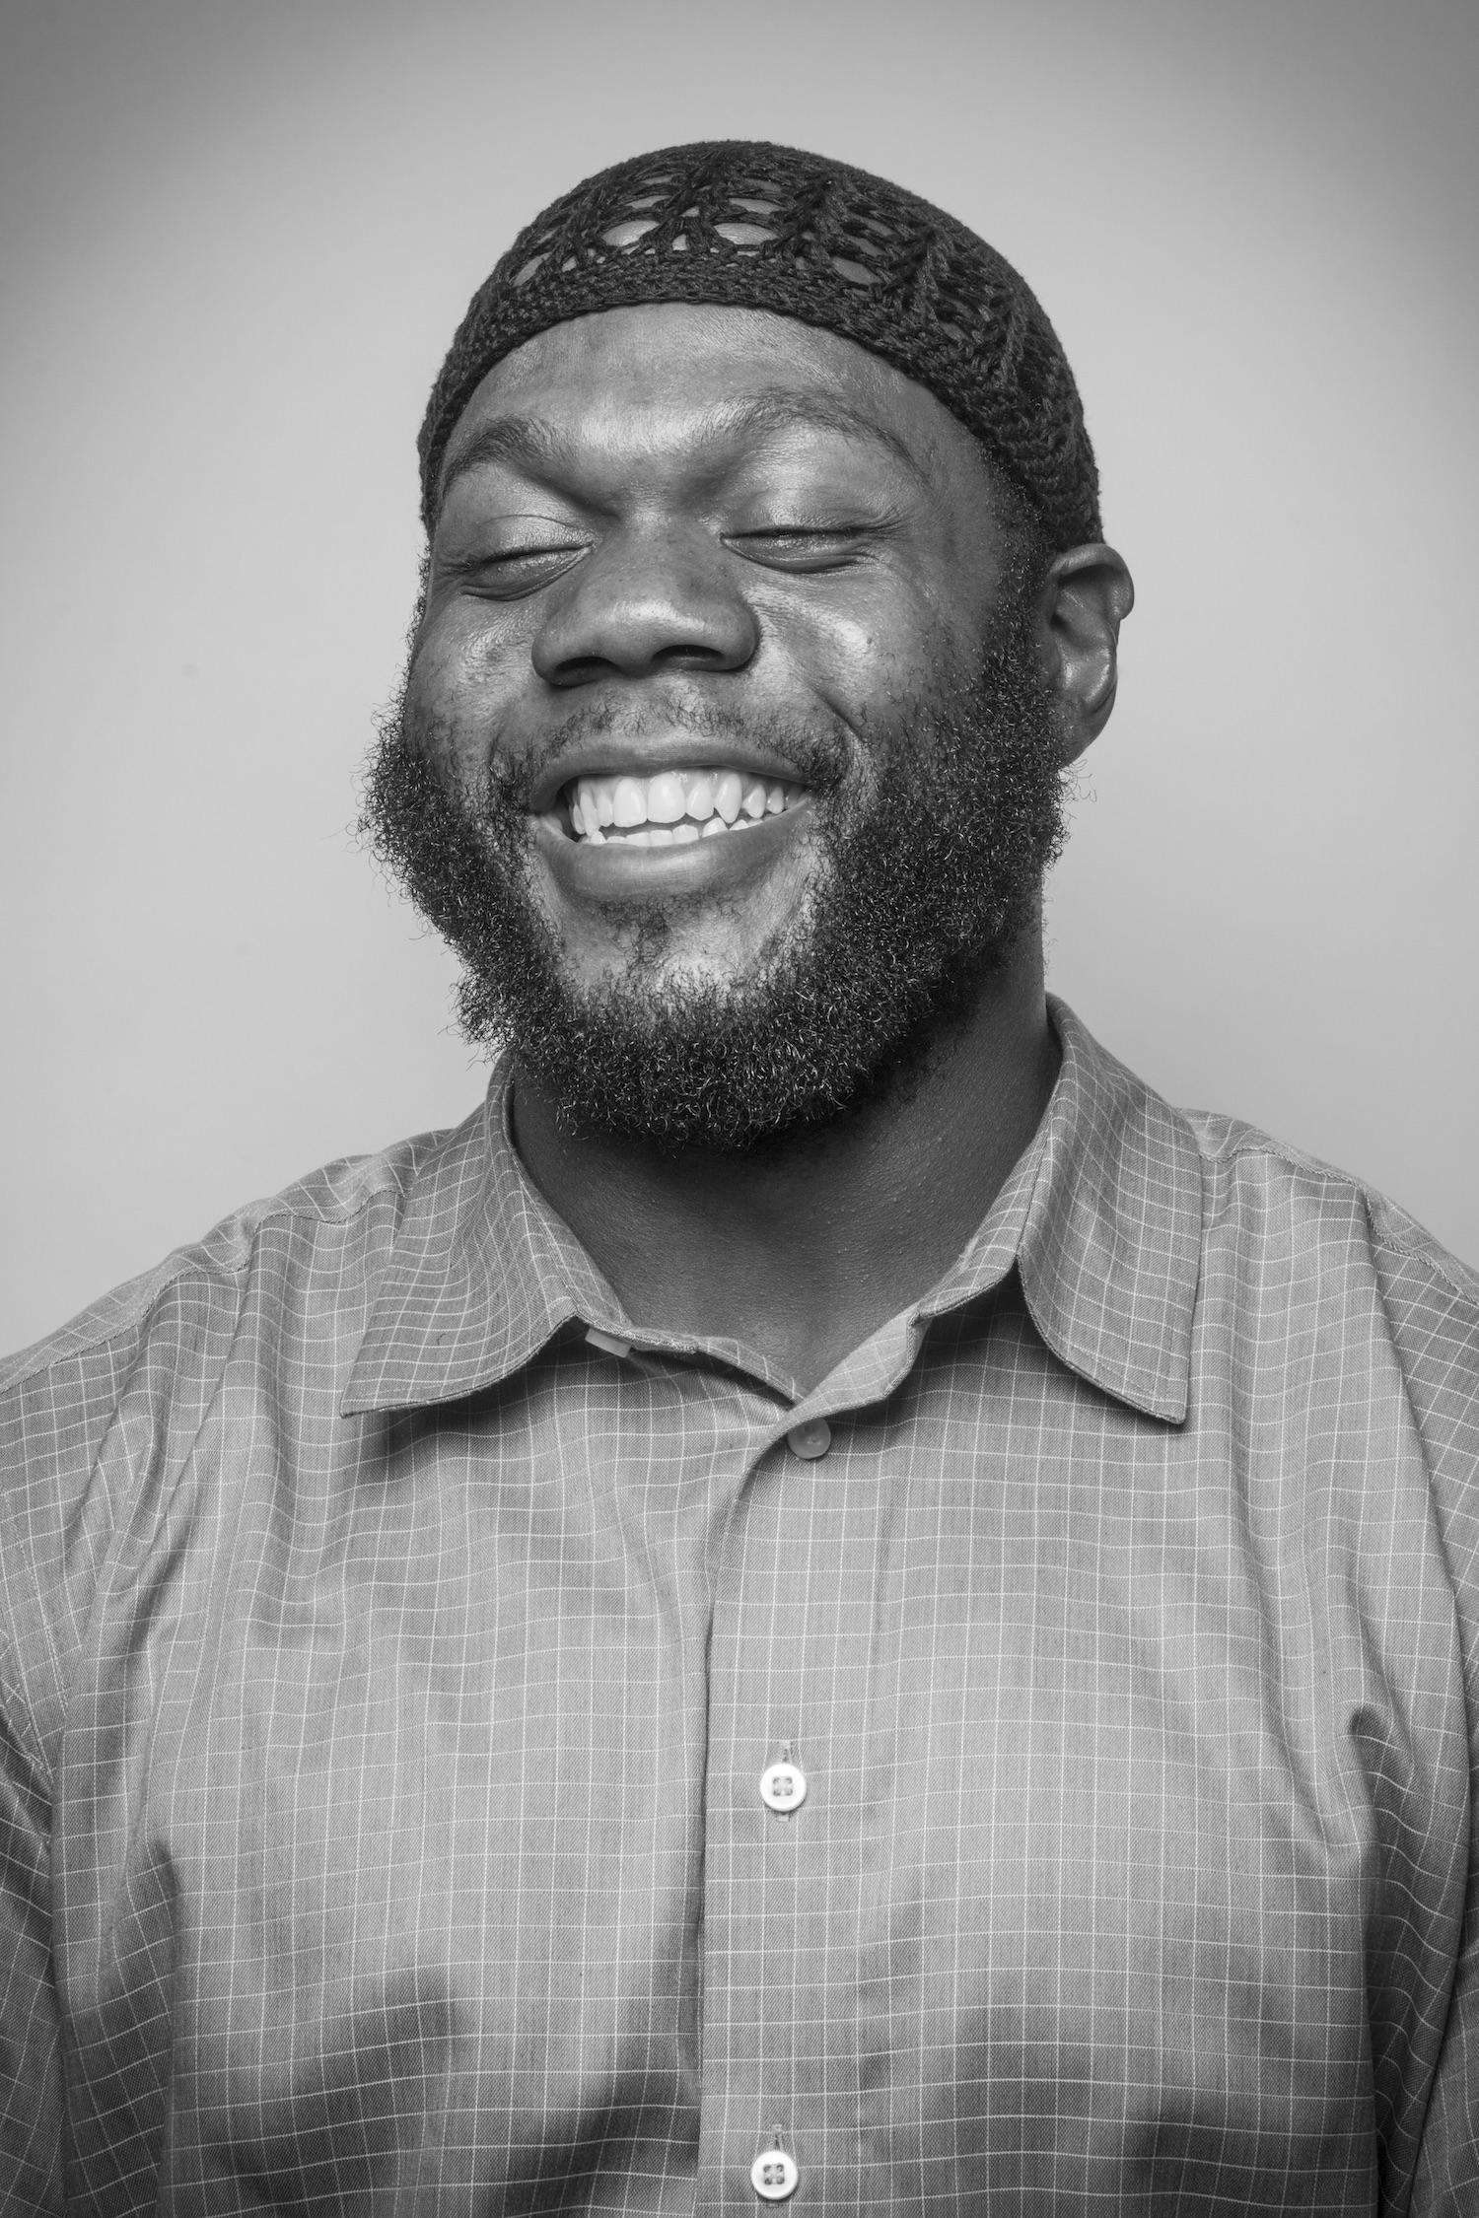
Leon El-Alamin
Notes:
Now I would like you to meet Leon El-Alamin. Leon is the founder of MADE institute in Flint, Michigan, a nonprofit organization that helps to re-integrate and provide job services to formerly incarcerated individuals. Leon is passionate about this cause because he himself was formerly incarcerated.
This work is important and one of the institute’s biggest initiatives was their successful campaign to “Ban the Box” in Genesee County. This initiative was intended to allow the removal of the requirement of noting incarceration history on job applications that prevents individuals with felony records from getting employed. This is an important initiative because it drastically reduces unemployment among formerly incarcerated people.
Leon’s work really reflects on the mindset that shows that we can learn from our past while looking forward to the future.

Slide 14
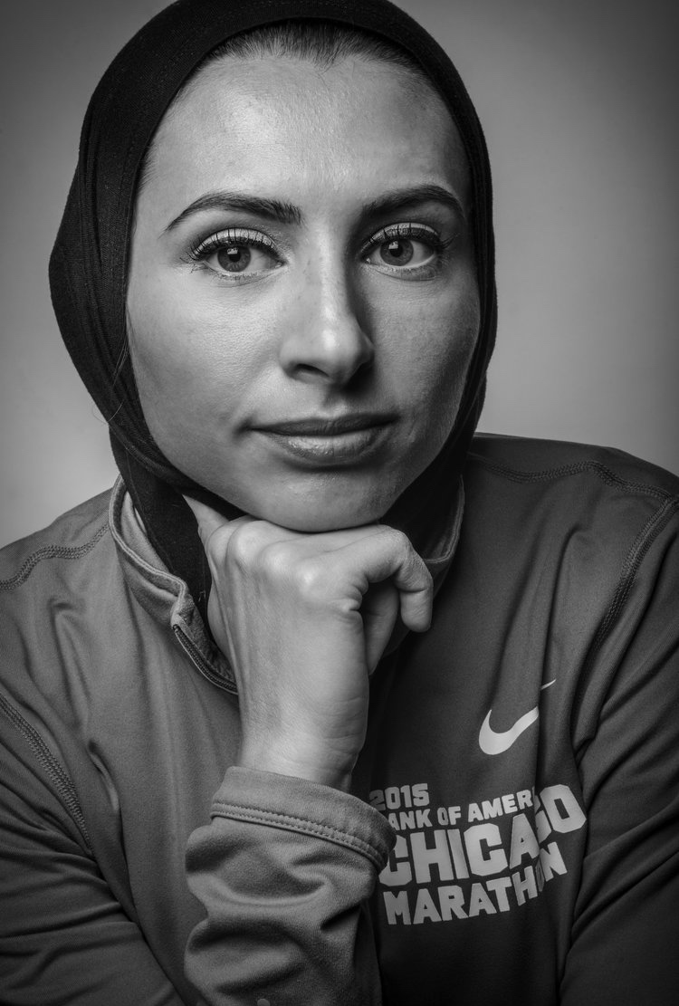
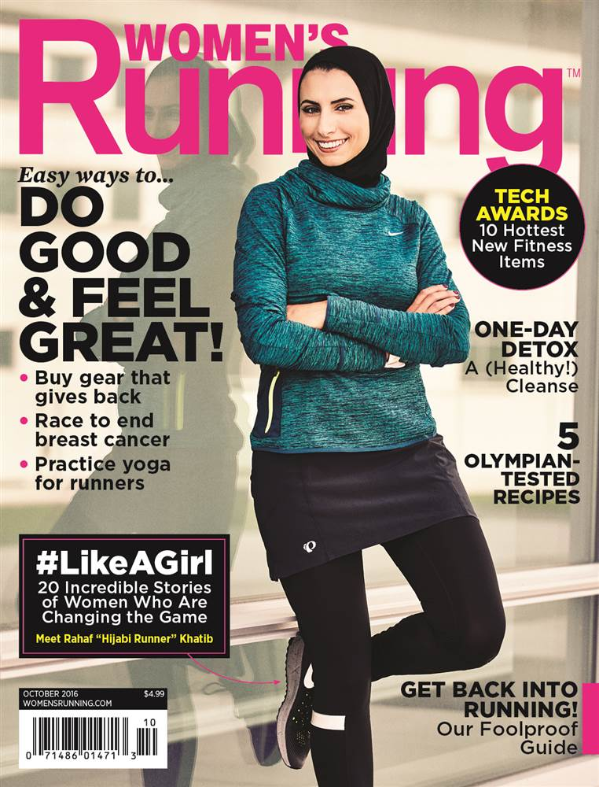
Rahaf Khatib
Notes:
The last person I’d like to introduce you to is Rahaf Khatib, an international marathoner who has completed 7 international marathons, 14 half marathons, and countless other races. Her first marathon was the Detroit Free Press run and she recently also ran the Boston marathon. Ahead of her Boston marathon, Rahaf used the thousands of Instagram followers she has and her immense online presence to raise money for charitable causes in Michigan. Rahaf has been featured in Runners magazine (click to bring in magazine cover) and also on Women’s running magazine.
Rahaf reminds us that sports have an amazing power to connect people from all walks of life, and like many other athletes, she recognized this power and harnessed it for good.
These are just a few of the diverse individuals who make up the American Muslim community. Let us now turn to some information about the American Muslim community as a whole.

Slide 15
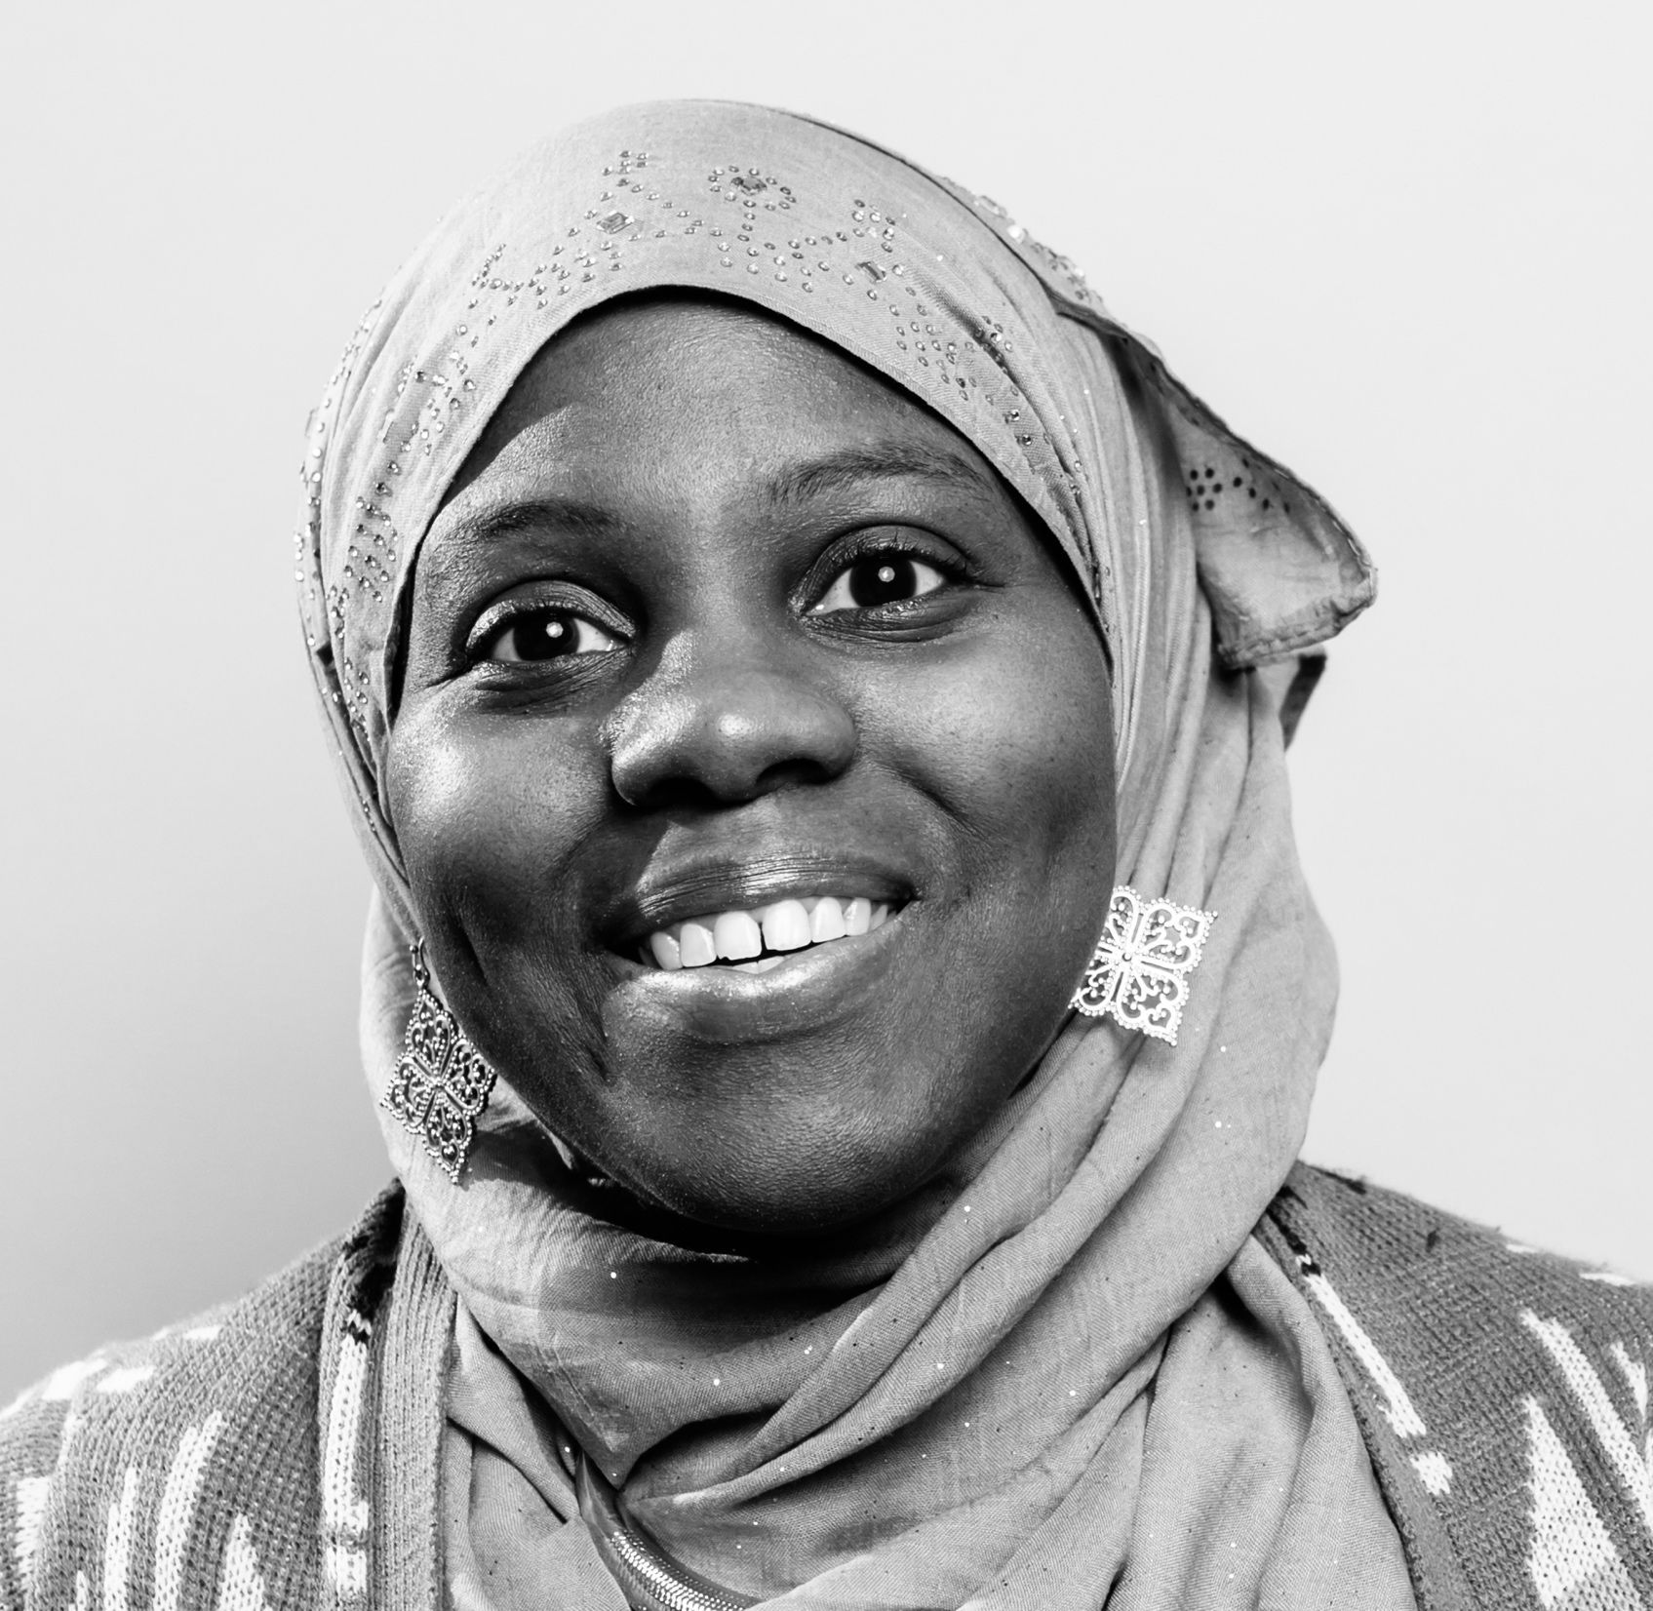
Nicole Najmah Abraham
Notes:
Meet Nicole Najmah Abraham. She is a Brooklyn native, mother, spoken word artist, and fashion photographer. She is also project manager for Green Earth Poets Café; workshop facilitator for New York State Senator Jesse Hamilton’s The Campus, a technology and wellness hub in Brooklyn; project contractor for the Center for Community Alternatives, which promotes community-based alternatives to incarceration; and visual marketer, producer, and social media manager for Halalywood Entertainment, an international halal production company. Abraham is a resident speaker and guest lecturer at the Fresno Kremen School of Education and Human Development, where she teaches master’s students. She additionally teaches hip-hop, poetry, and fashion design to youth within the juvenile detention system, as well as prisons in and around New York. Abraham has worked in the New York City fashion industry for almost 15 years, having designed for Walmart, Ecko, Rocawear, U.S. Polo Association, Jordache Jeans, Children’s Apparel Network, and House of Deréon (Beyonce’s fashion line). Abraham founded a forum and storytelling project known as “I Am More Than a Scarf,” featuring Muslim women.

Slide 16
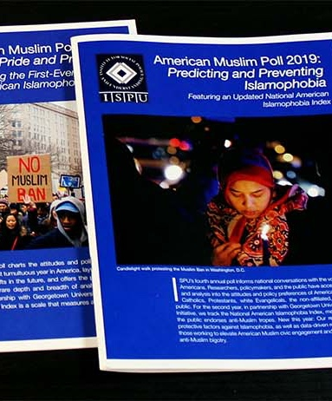
American Muslim Poll
Data collected in 2016, 2017, 2018, 2019
Nationally representative sample of Muslims, Jews, Protestants, white Evangelicals, Catholics, and non-affiliated Americans
All participants given identical surveys
Notes:
AMP provides a portrait of a deeply misunderstand community, not as an isolated specimen, but rather as a community within America’s faith landscape. The resulting data and comparisons lay the foundation for a greater understanding of American Muslims beyond typical one-dimensional portrayals linked to bigotry or threats to national security. ISPU’s poll is the only nationally representative survey of American Muslims done on an annual basis and is widely referred to by faith leaders, advocates, policy makers, journalists, and community leaders to help them do their work smarter and more effectively.

Slide 17
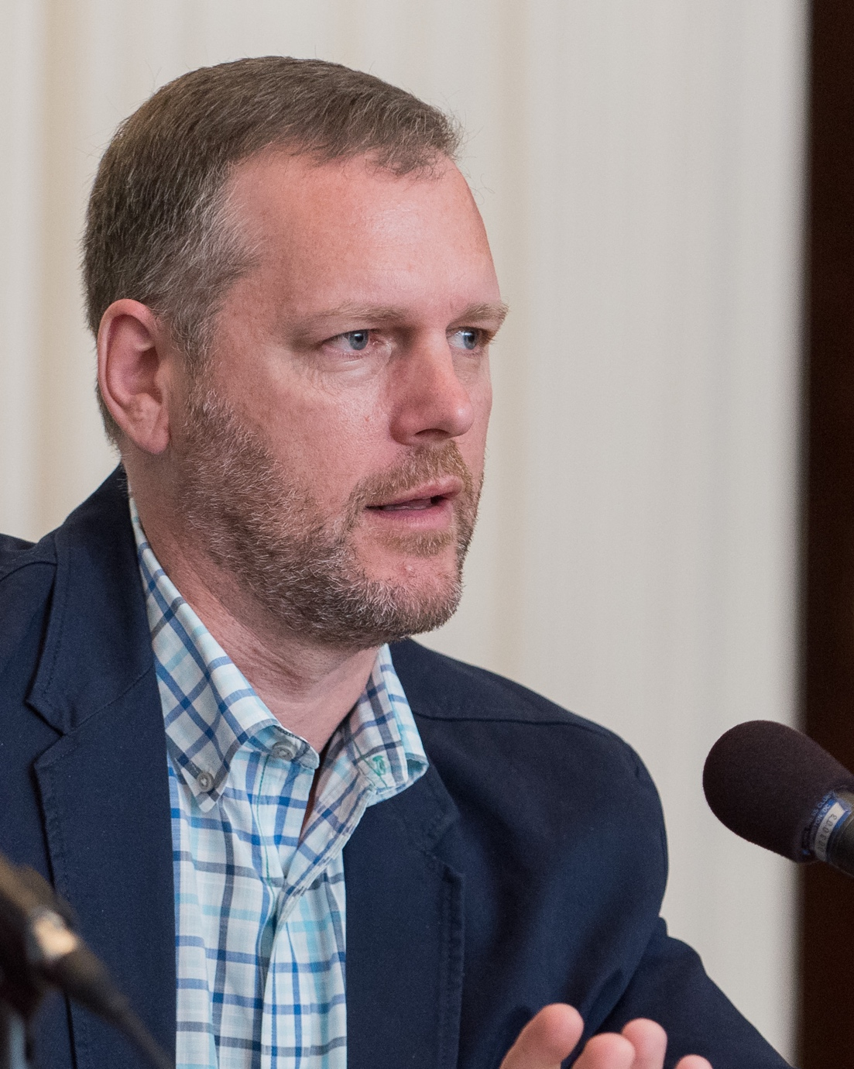
Poll Methodology
Survey fielded by SSRS
Dr. David Dutwin, Chief Methodologist
Past President of AAPOR (American Association of Public Opinion Research)
Polling for CNN, CBS, ABC, The Washington Post, and American Public Media
Learn more at www.ispu.org/poll
Notes:
The Chief Methodologist for the American Muslim Poll is Dr. David Dutwin, Executive Vice President and Chief Methodologist of SSRS. SSRS is the firm that fields the study. David and SSRS are responsible for
polling for the following news outlets: CNN, CBS, ABC (Gary Langer), The Washington Post, and American Public Media/Minnesota Public Radio. David is also a Past President of AAPOR, the American Association of Public Opinion Research and experienced Research Scholar on surveying Jewish Americans. Specifically, he is Cheif Methodologist for the American Jewish Committee’s Survey of Jewish Public Opinion.
All participants in the study were given identical surveys and the data are weighted to be nationally representative.

Slide 18
Muslims are ethnically diverse, young, and American
Notes:
Let’s start with the basics. American Muslims are the most ethnically diverse, and youngest American faith group.

Slide 19
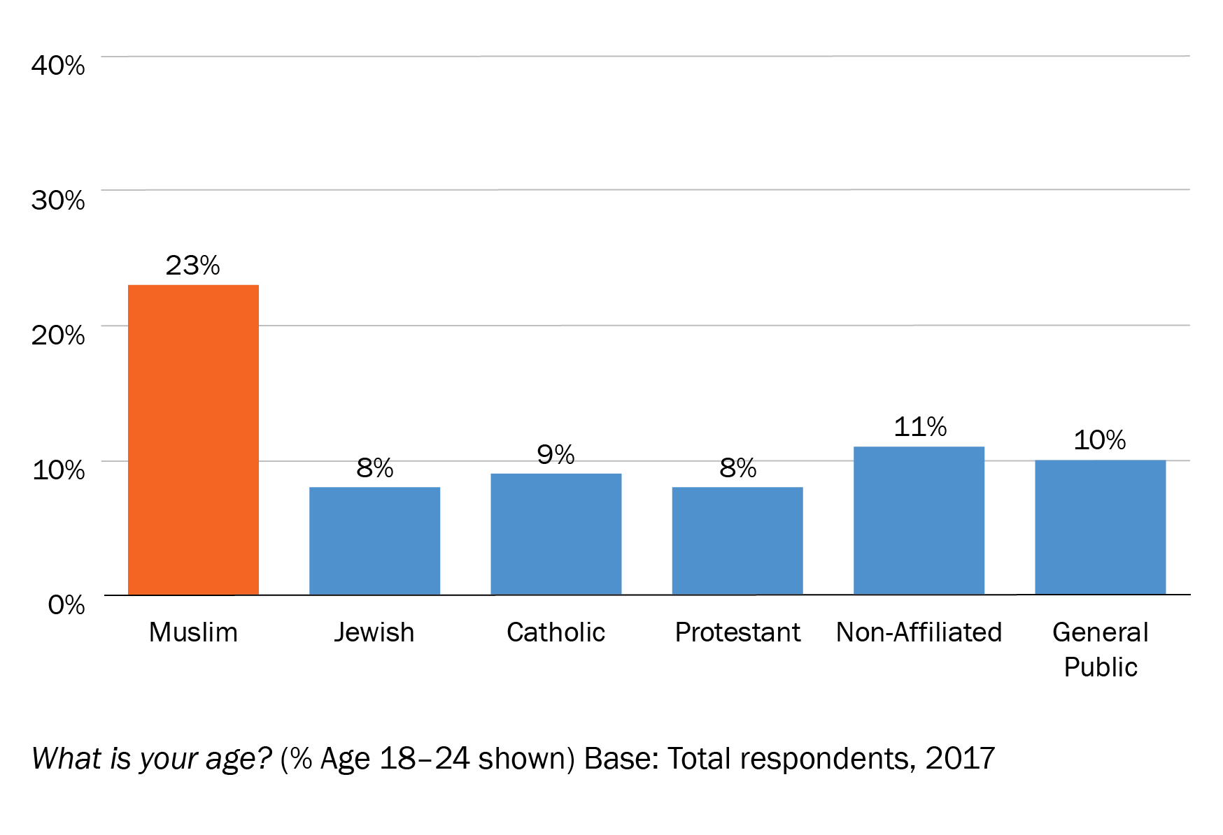
Muslims America’s youngest faith community
Notes:
Muslims are the youngest faith community in America.
Nearly ¼ are between 18-24 years old.
(Note: If you are presenting this to an audience of teachers or educators, you might add the following: “What happens at this time in schools will pave the way for a large generation”)

Slide 20
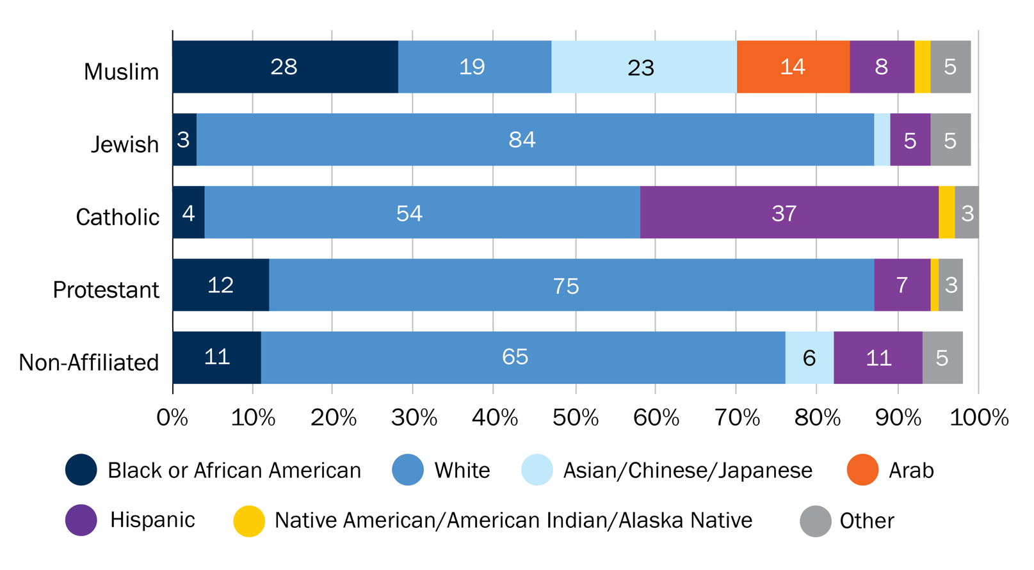
Muslims most ethnically diverse faith community
Notes:
Muslims are also the most ethnically diverse faith community in America.
It is the only community without a majority race with ¼ black, ¼ white (albanian, turkish, soviet union, converts), 18% Arab (contrary to popular myth) and 18% Asian. The community also includes a smattering of Hispanics, Native American, Mixed and other ethnicities.
American Muslims look like what all of America will look like in the future, no majority race.

Slide 21
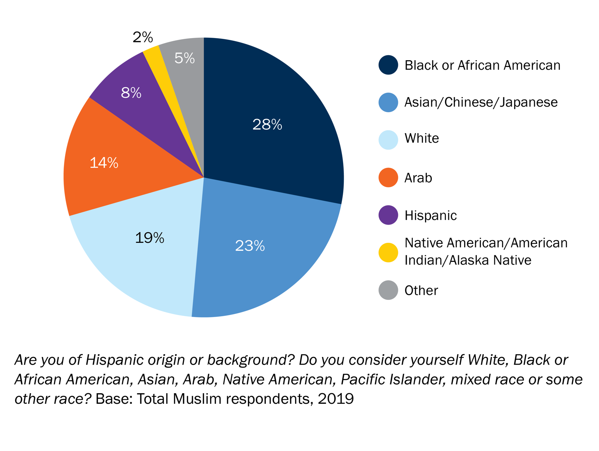
Muslims most ethnically diverse faith community
Notes:
Muslims are also the most ethnically diverse faith community in America
Only community without majority race
¼ black, ¼ white (albanian, turkish, soviet union, converts), 18% Arab (contrary to popular myth) and 18% Asian
Smattering of Hispanics, Native American, Mixed and other

Slide 22
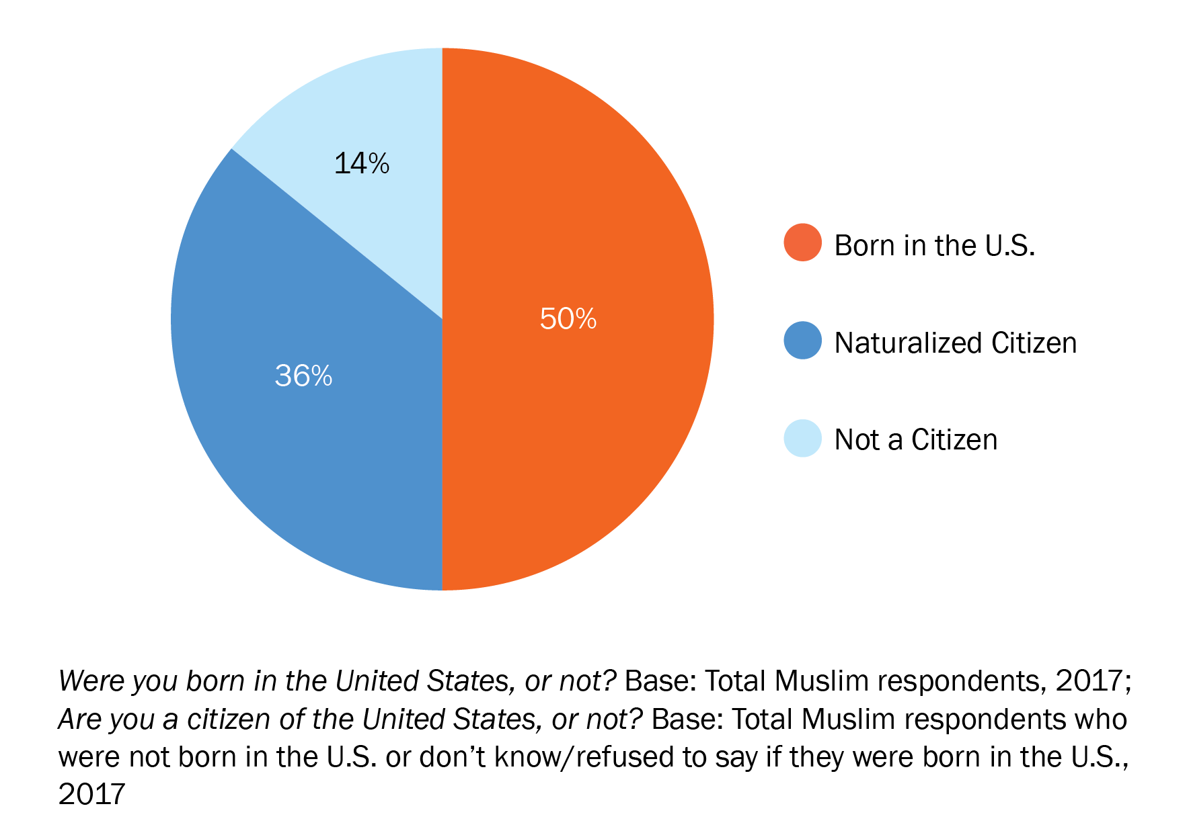
Half of American Muslims are native born
Notes:
86% of Muslims are American – through birth or naturalization
Immigration is still very much part of the Muslim story – 50% of Muslims are born outside the US.
But not the whole story – Muslims have been here since America’s founding – part of the country since its inception
The fact that young Muslims are both diverse racial/ethnic and immigrant – getting targeted on multiple fronts.

Slide 23
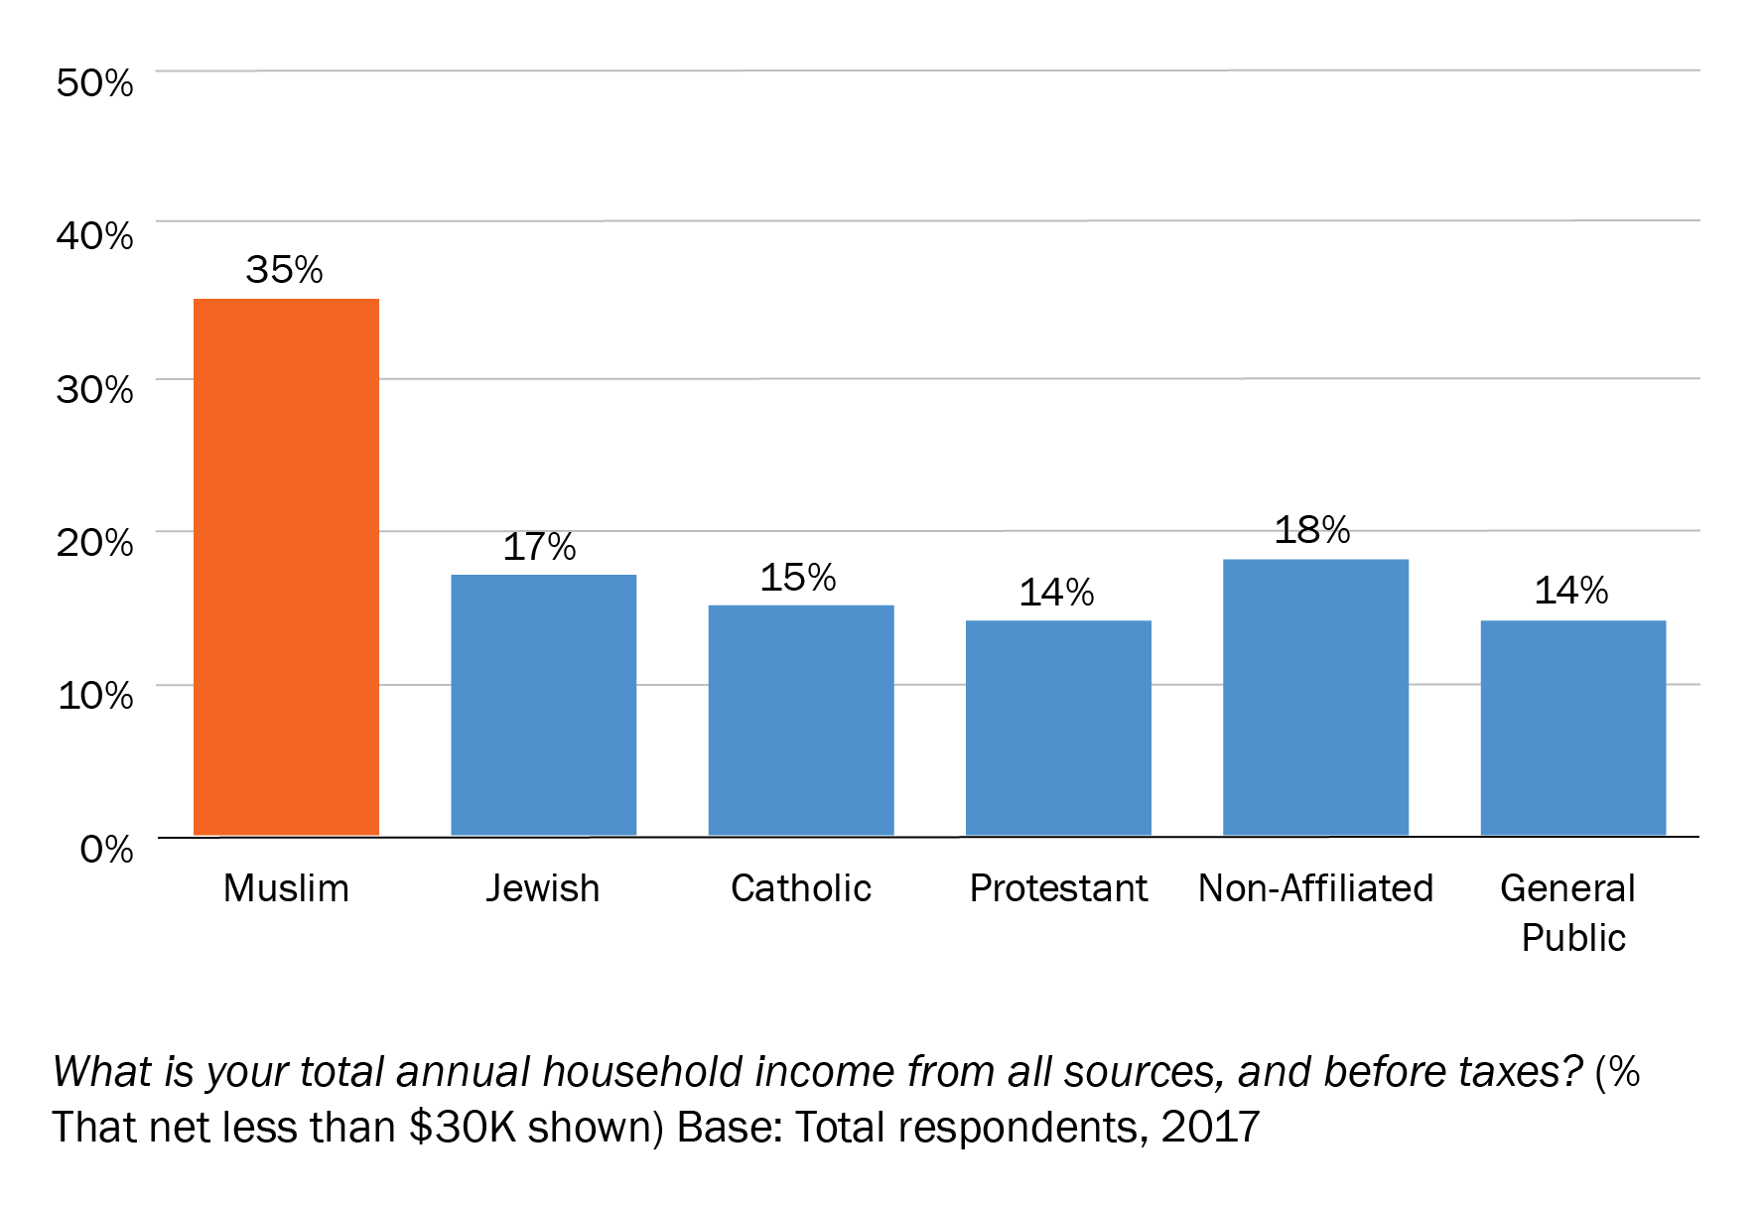
Muslims most likely to report low income
Notes:
Sometimes Muslims are portrayed as all being rich doctors. Yes, there are rich Muslims but there are also poor Muslims and in fact, Muslims are the most likely faith community to report low income, with roughly a third living at or just below the poverty line.
Black and Arab Muslims are the most likely to report low income.

Slide 24
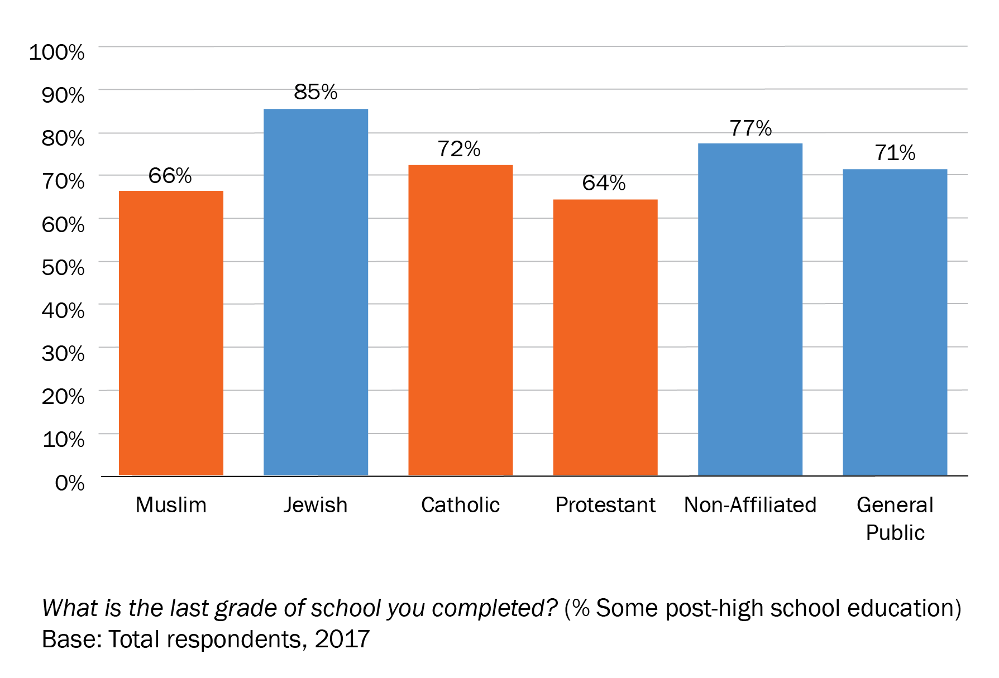
Muslims, Christians similar in level of education
Notes:
However, Muslims are as likely as Christians to be well educated, suggesting that for some their income is lower than their level of education might predict. This is the case for communities with a large number of refugees, a reality for American Muslims for the past two decades.

Slide 25
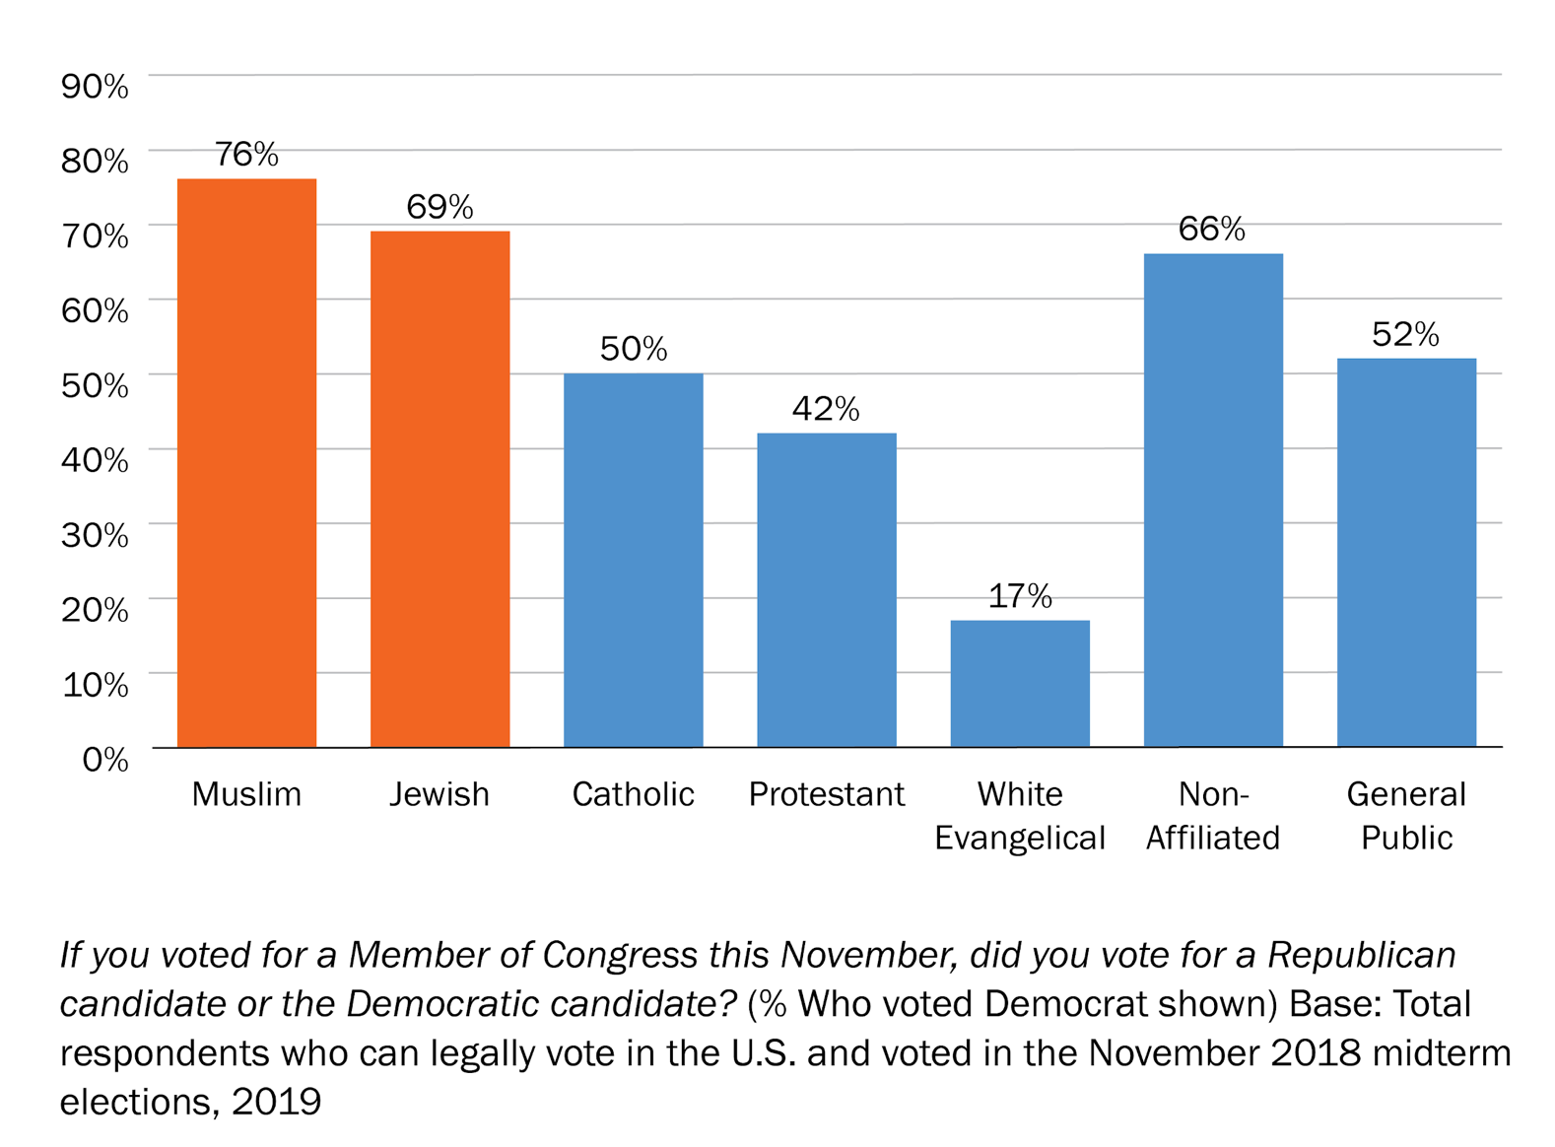
Muslims, Jews most likely to have voted for a Democrat in 2018 midterms
Notes:
Muslims and Jews are the most likely to identify as democrats and to have voted for a democrat in the 2018 midterm elections.

Slide 26
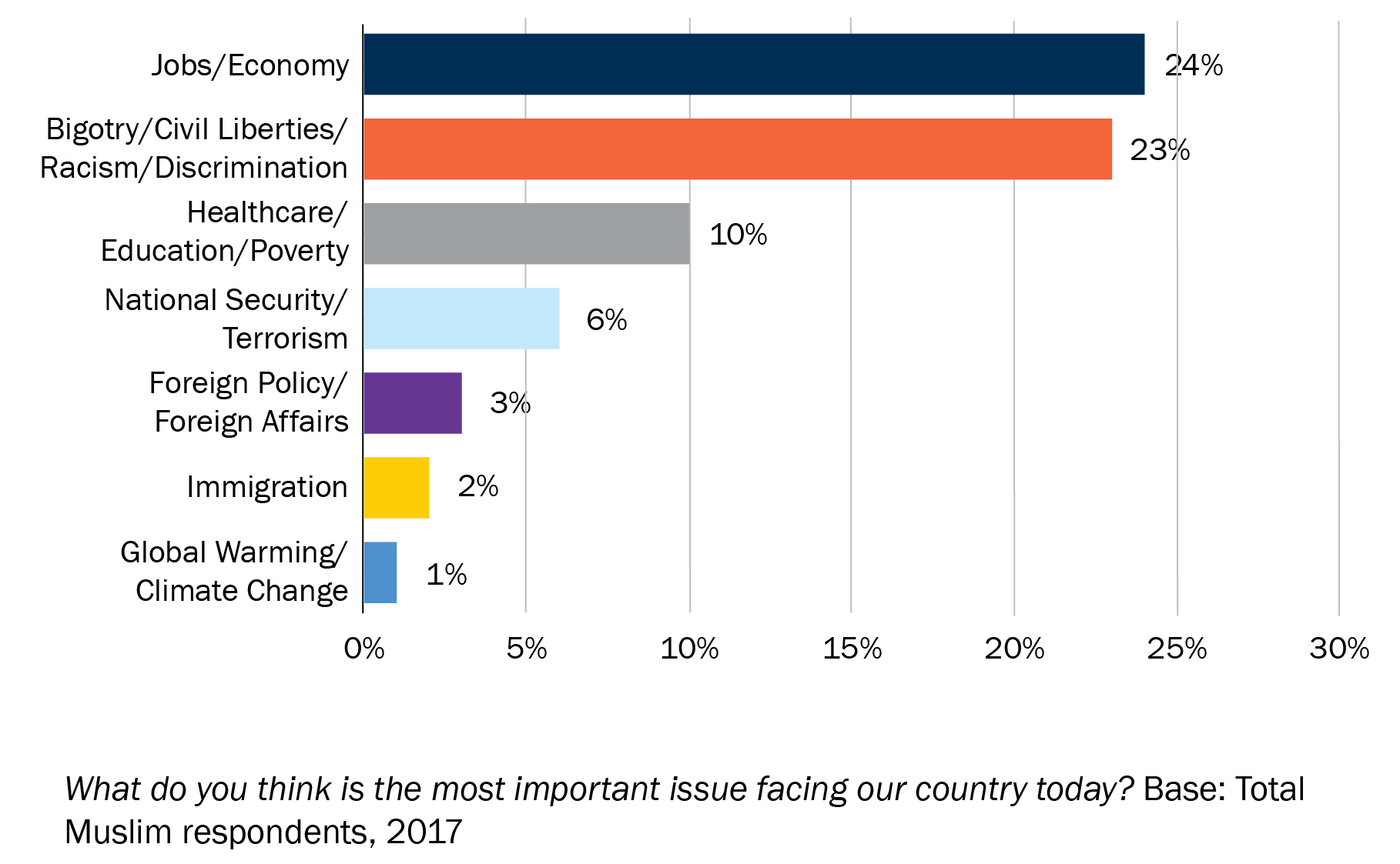
Economy and bigotry continue to top Muslim priorities
Notes:
But Muslims don’t just care about ‘Muslim’ issues. Like many other Americans, jobs/economy is their #1 concern.
They are equally concerned about civil rights and racism in America.
Top concerns also include healthcare, education and poverty.

Slide 27
Muslims disproportionately feel negative effect of political climate

Slide 28
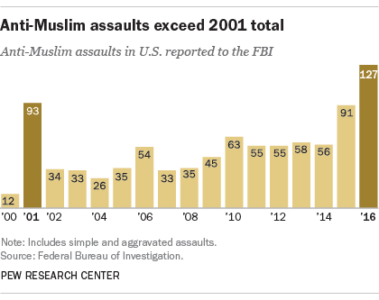
Hate crimes climb
Notes:
According to the FBI, Hate crimes targeting Muslims were higher in 2016 than any year on record, including right after 9/11.

Slide 29
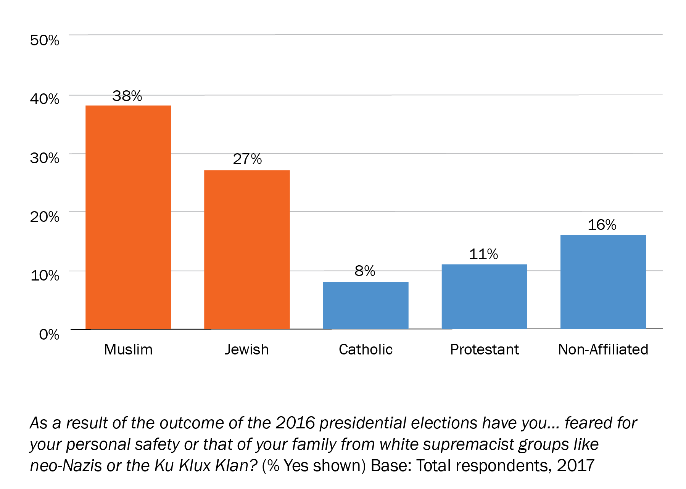
Muslims, Jews experience the most fear, anxiety post 2016 election
Notes:
It is then not surprising that Muslims and Jews are the most likely to express anxiety and fear for their personal safety from hate-based attacks after the 2016 elections. Though hate crimes are rare, their psychological impact on the wider targeted community is more widespread.

Slide 30
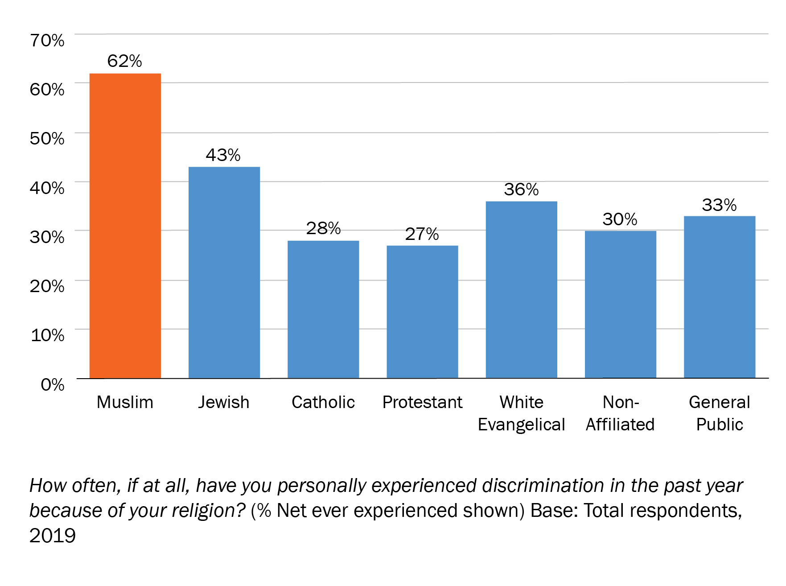
Muslims experience the most religious discrimination
Notes:
Hate crimes are rare but everyday discrimination is much more common.
Sixty percent of American Muslims report experiencing some frequency of faith-based discrimination, higher than any other group.
Among Muslims, the most likely to say they experienced discrimination are women, young people and Arabs.

Slide 31
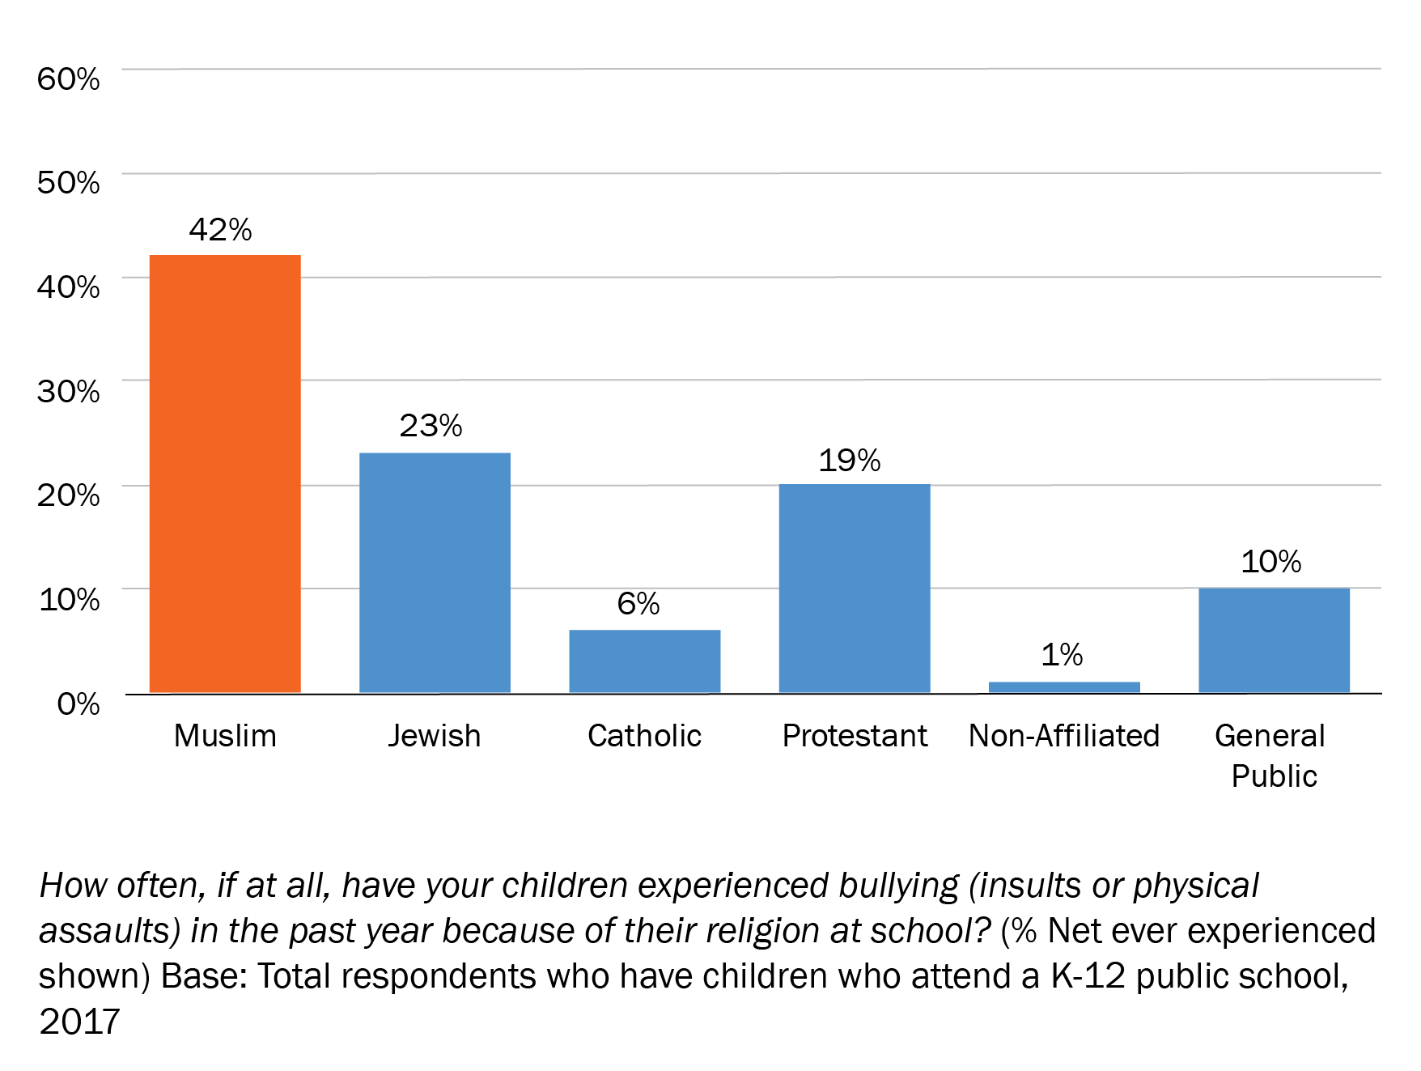
Muslim families most likely to face bullying
Notes:
And unfortunately this negative impact is not limited to adults. Forty-two percent of Muslim families with kids in grade school report that their children experienced bullying because of their faith, higher than any other faith community surveyed.
It’s important to note that bias-based bullying has more negative affect on children than regular variety – as it is seen to be based on an integral part of who they are, something they can’t change – so the child anticipates it to keep happening over and over.

Slide 32
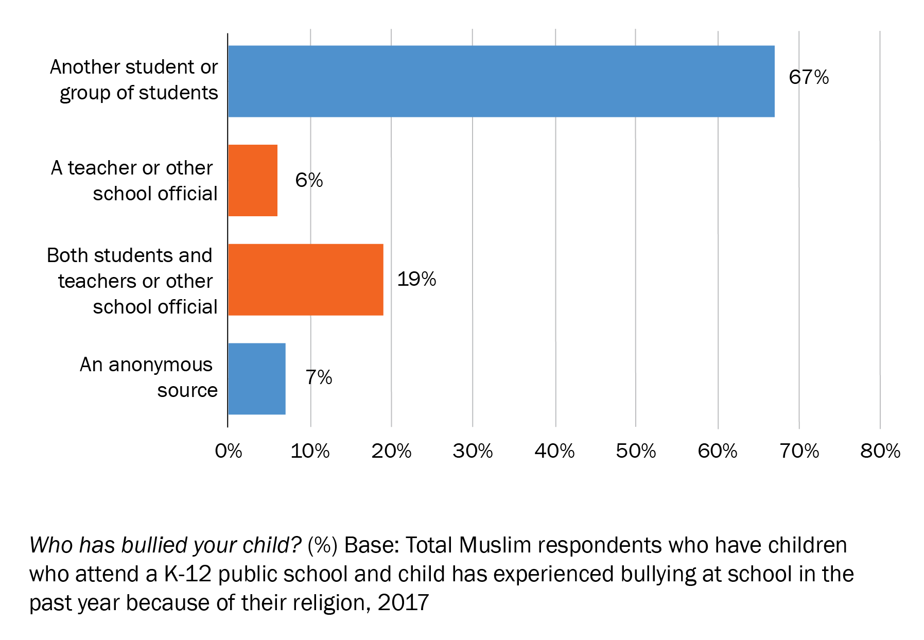
One in four Muslim bullying incidents involves a teacher
Notes:
What was especially unsettling, however, was the fact that a quarter of the bullying incidents involved a teacher or administrator as the bully. This underscores the need for better training of our educators.

Slide 33
Muslims respond with faith, civic engagement and solidarity with other targeted groups

Slide 34
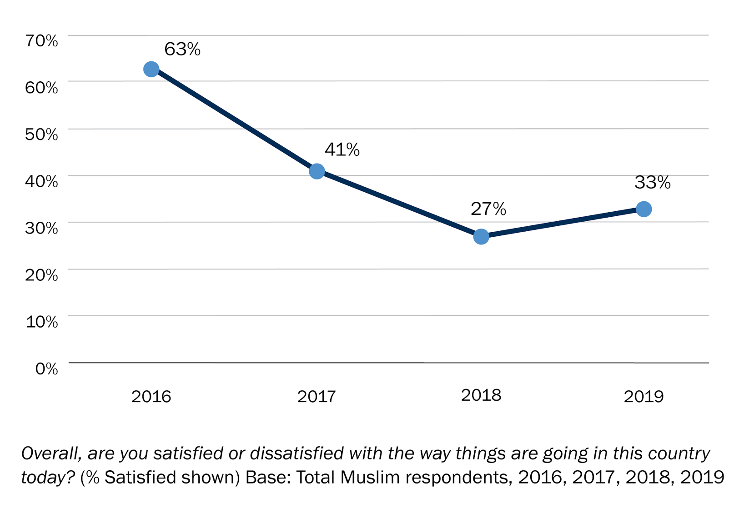
Muslim satisfaction with direction of country has declined since 2016
Notes:
Considering the current political climate, it is not surprising that Muslims are finding things in the US today difficult.
Satisfaction with the way the country is going has nosedived since 2016.

Slide 35
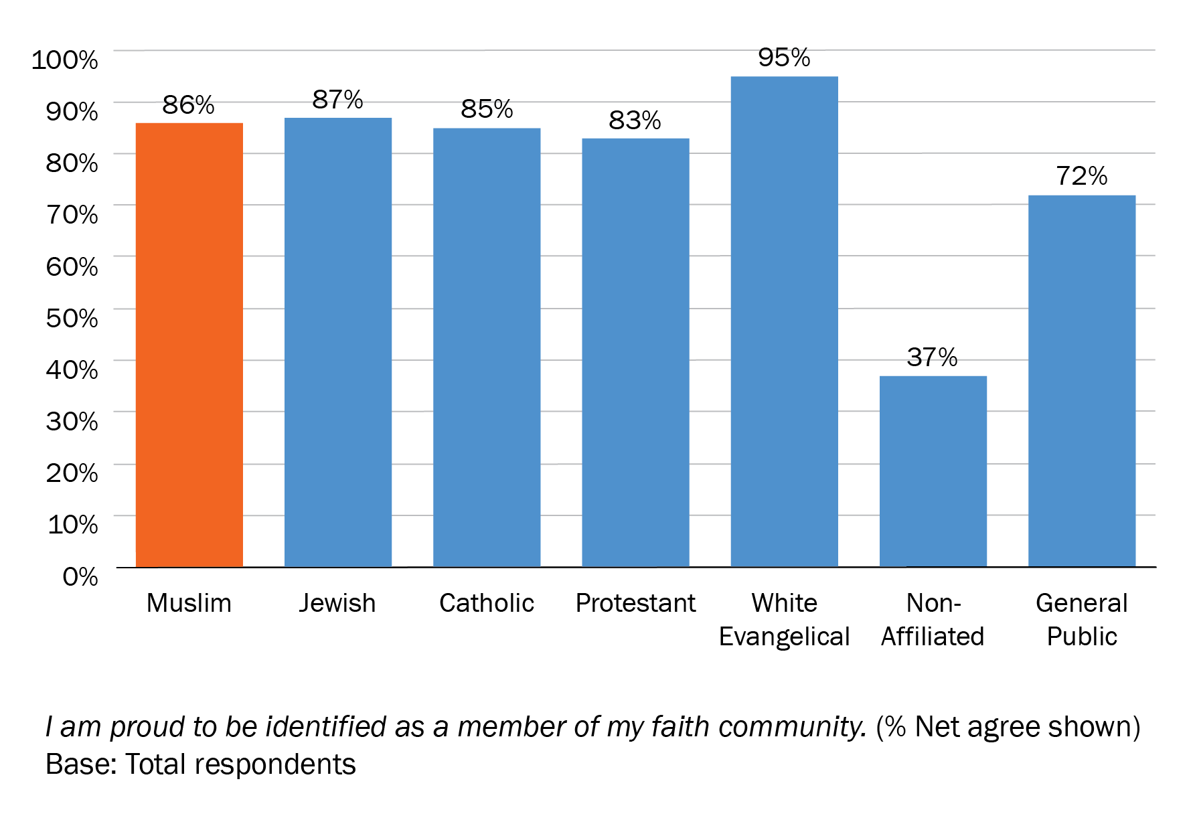
Most Muslims are proud to identify as members of their faith community
Notes:
Despite all the challenges, Muslims, like other Americans of faith, are proud of their identity and see it as a source of great happiness.

Slide 36
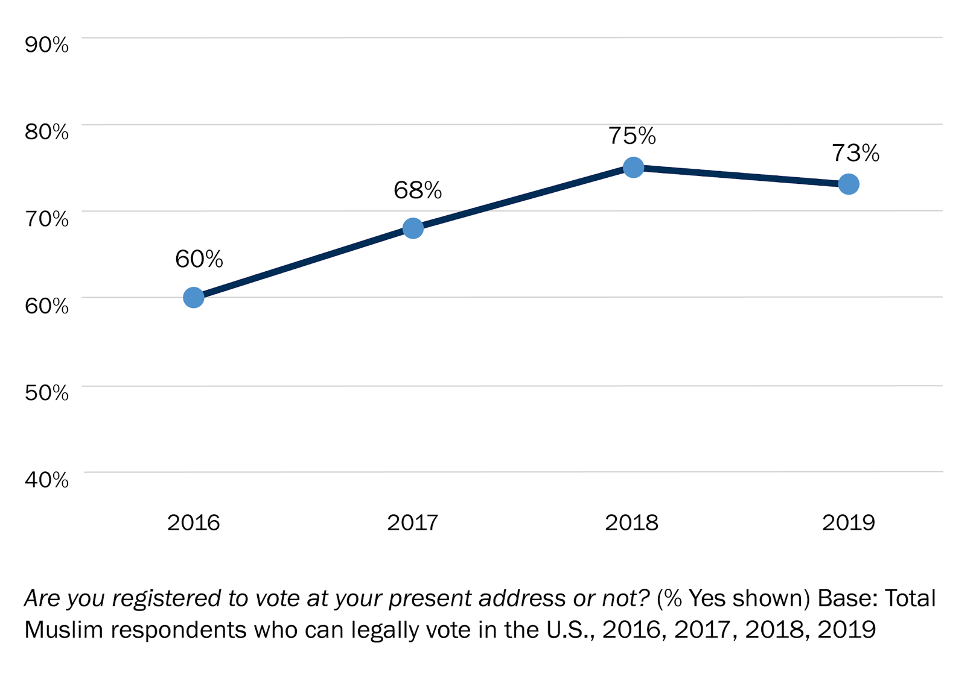
Muslim voter registration grows steadily
Notes:
And this has caused a jump in civic engagement. Record numbers of Muslims are running for office, including the recent election of 2 Muslim women to congress for the first time ever, and a spike in voter registration.
In fact, we find that Muslims who attend the mosque more frequently are more civically engaged.

Slide 37
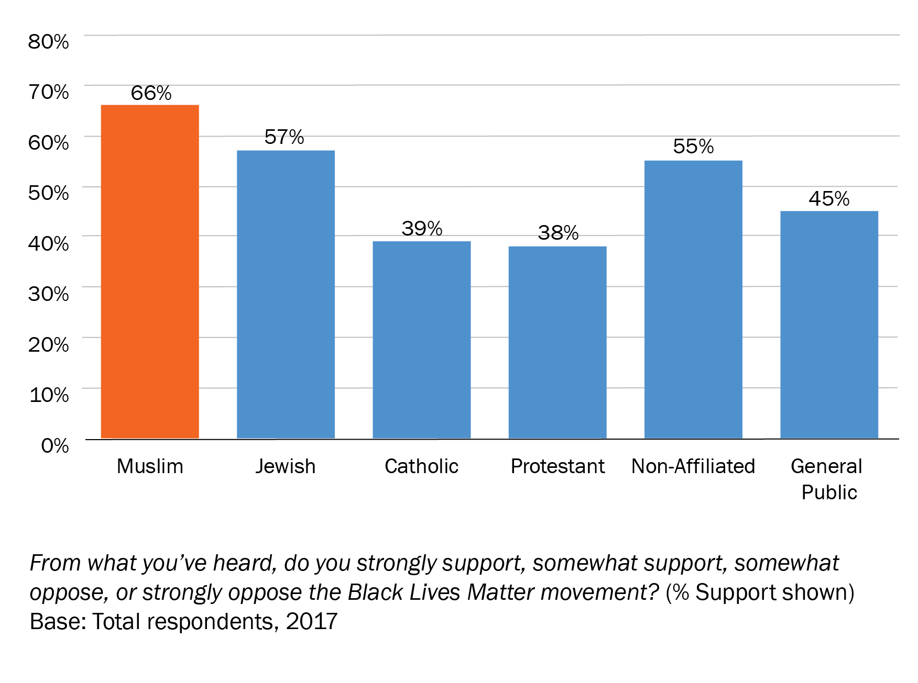
Muslims most likely faith group to support Black Lives Matter movement
Notes:
It is then not surprising that American Muslims are the most likely group to support the Black Lives Matter movement. Of course a full
quarter to third of Muslims are also Black, but non-Black Muslims are significantly more likely than the general public to support Black Lives Matter. Moreover, Asian Muslims, as well as Muslim women as a group, are as likely as Black Americans and Black Muslims to express support.

Slide 38
Some Myth Busters…

Slide 39
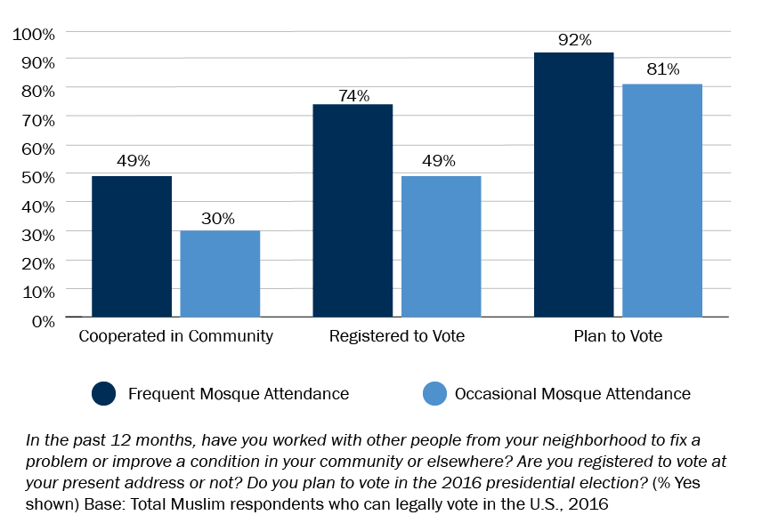
Frequent mosque attendance linked to greater civic engagement
Notes:
Mosques are good for democracy. Attending a mosque more frequently is linked to greater likelihood to volunteer in your community to solve a problem to be registered to vote, and to intend to vote.

Slide 40
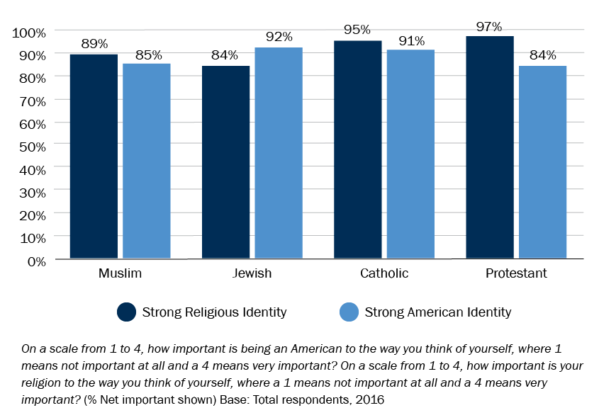
American faith groups share strong religious and American identities
Notes:
Like other Americans, Muslims identify strongly with their faith and with being an American.

Slide 41
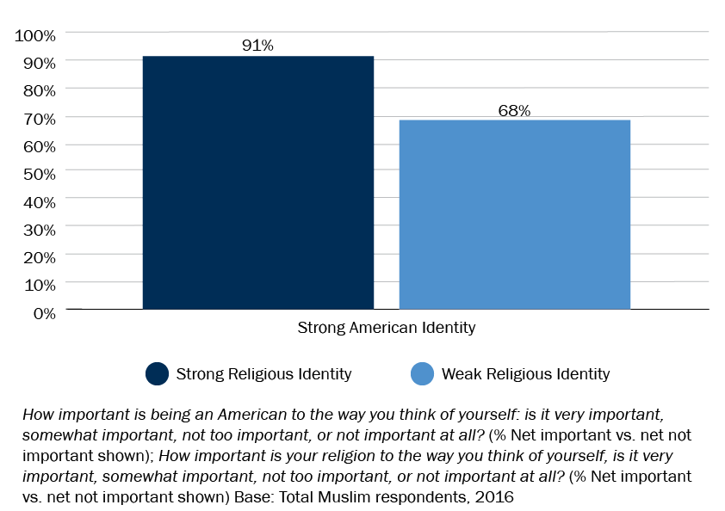
Muslims with strong religious identities are more likely to have strong American identities
Notes:
But how do these two identities relate? Does a stronger religious identity correlate with a weaker American identity? The answer is no. In fact, Muslims with a stronger religious identity have a stronger American identity than Muslims with a weak religious identity.

Slide 42
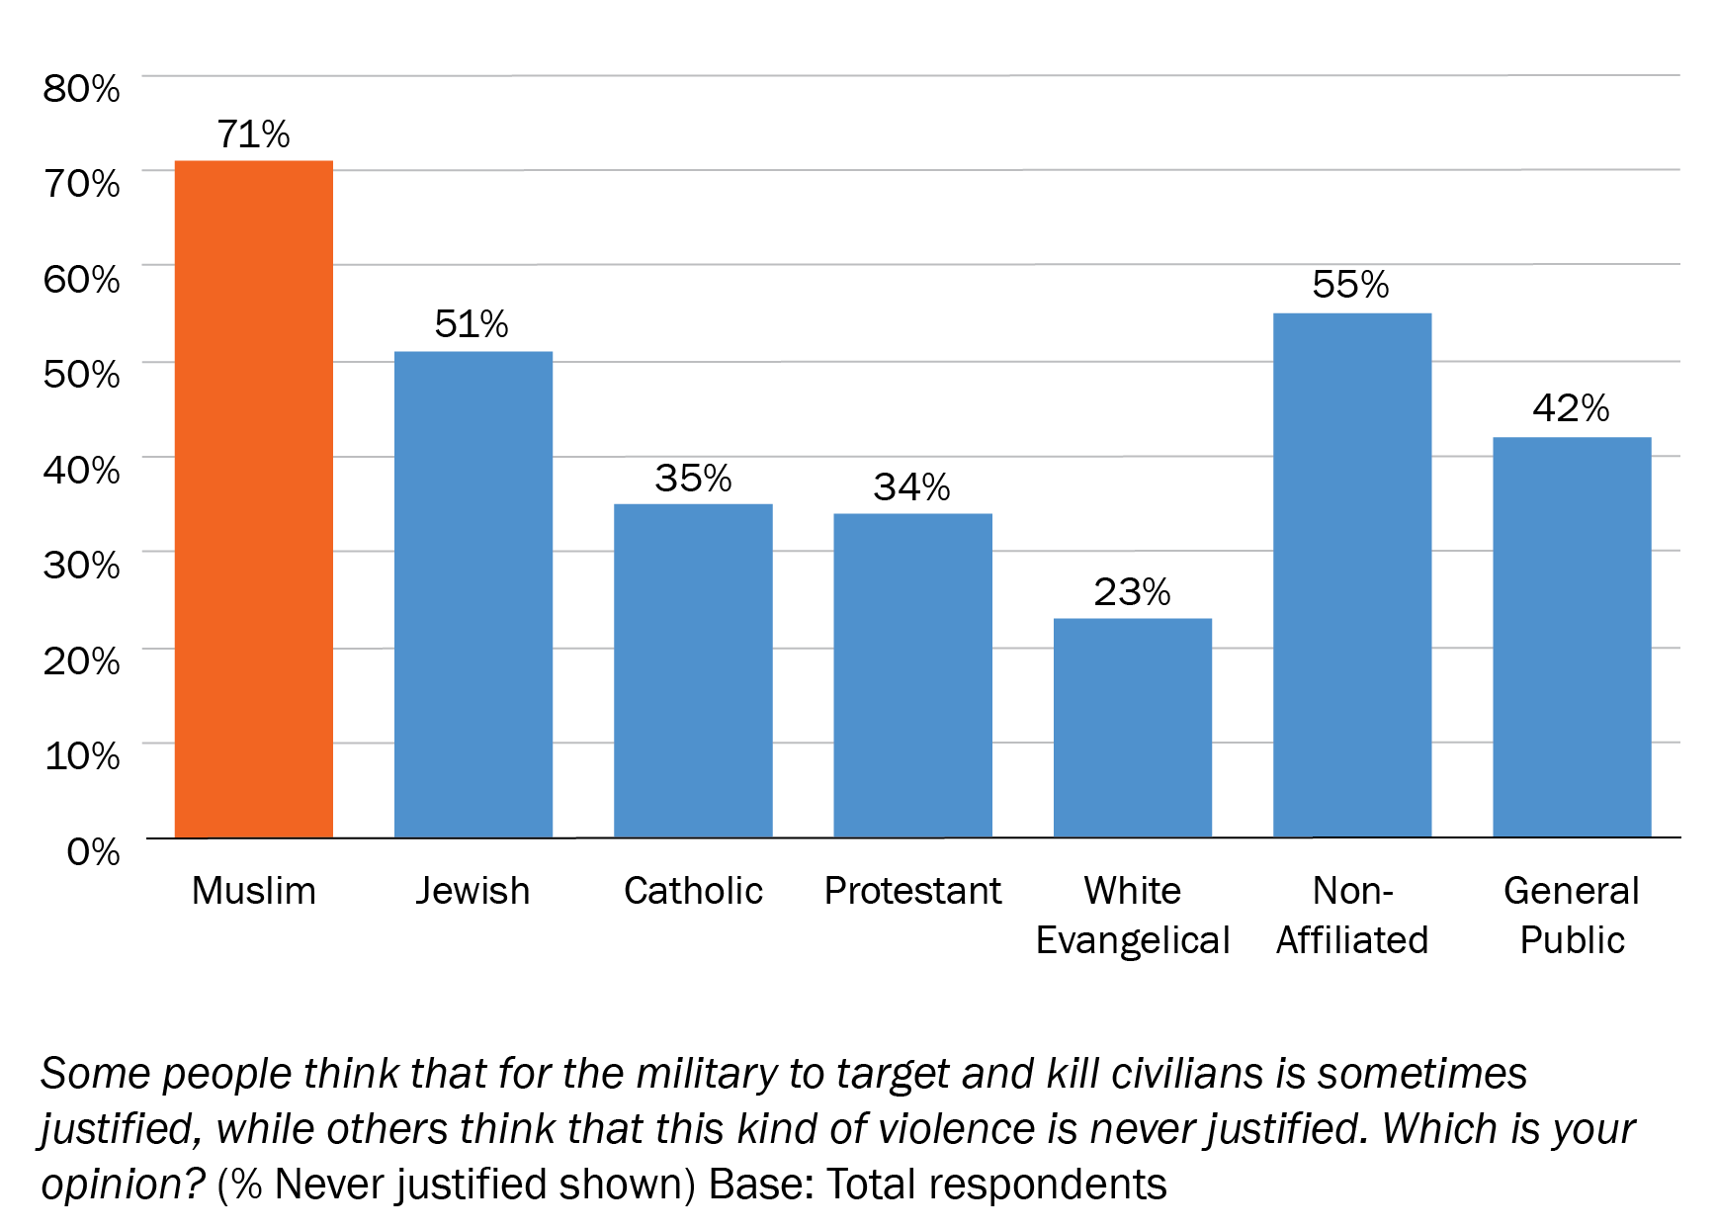
Muslims most likely to reject military attacks on civilians
Notes:
Muslims are also among the most likely faith group in America to unequivocally reject individual targeting of civilians.

Slide 43
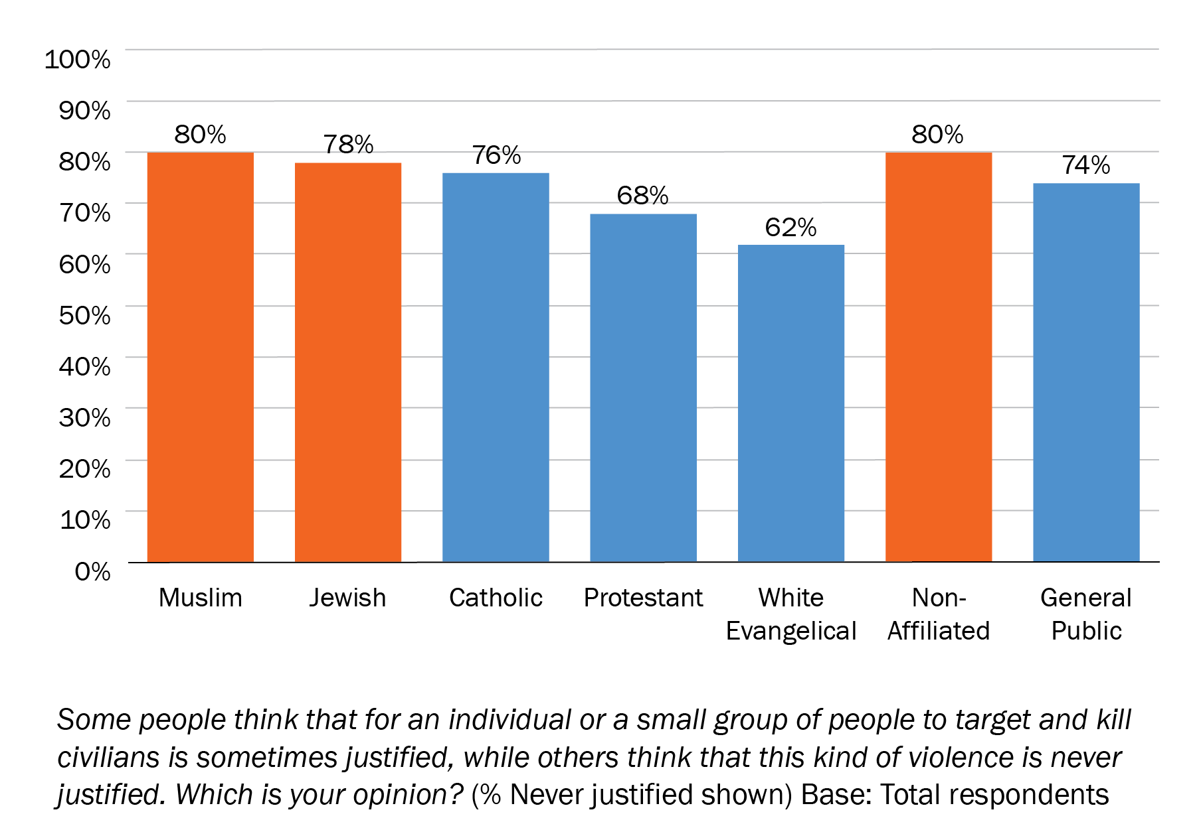
Muslims, Jews, non-affiliated most likely to reject individual attacks on civilians
Notes:
Muslims are also among the most likely faith group in America to unequivocally reject individual targeting of civilians.

Slide 44
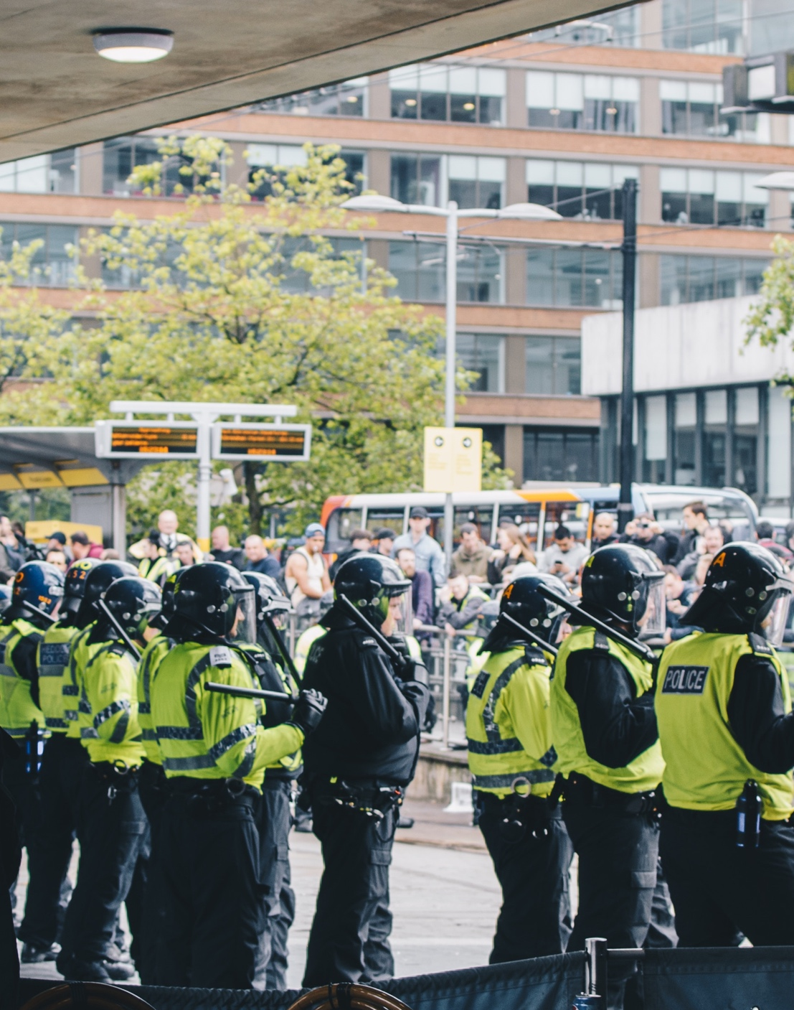
Most American Terrorist Fatalities Are at the Hands of White Supremacists
The majority of American fatalities at the hands of extremists are from right-wing terrorists.
Law enforcement agencies ranked anti-government extremists as a greater threat than terrorist orgs like Al Qaeda.
Source: “Terrorism Cases Involving Muslim-Americans,” Charles Kurzman and David Schanzer, 2014

Slide 45
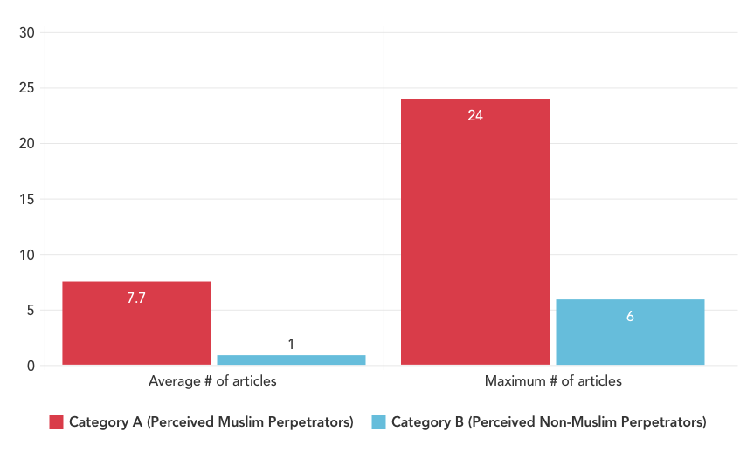
Muslim-perceived perpetrators of violence receive 770% more media coverage than other perpetrators
Notes:
According to an ISPU study of Media and Legal responses to Ideologically Motivated Violence, perpetrators of violent plots who are perceived to be Muslim receive 770% more media coverage compared to non-Muslim perpetrators of similar crimes.

Slide 46
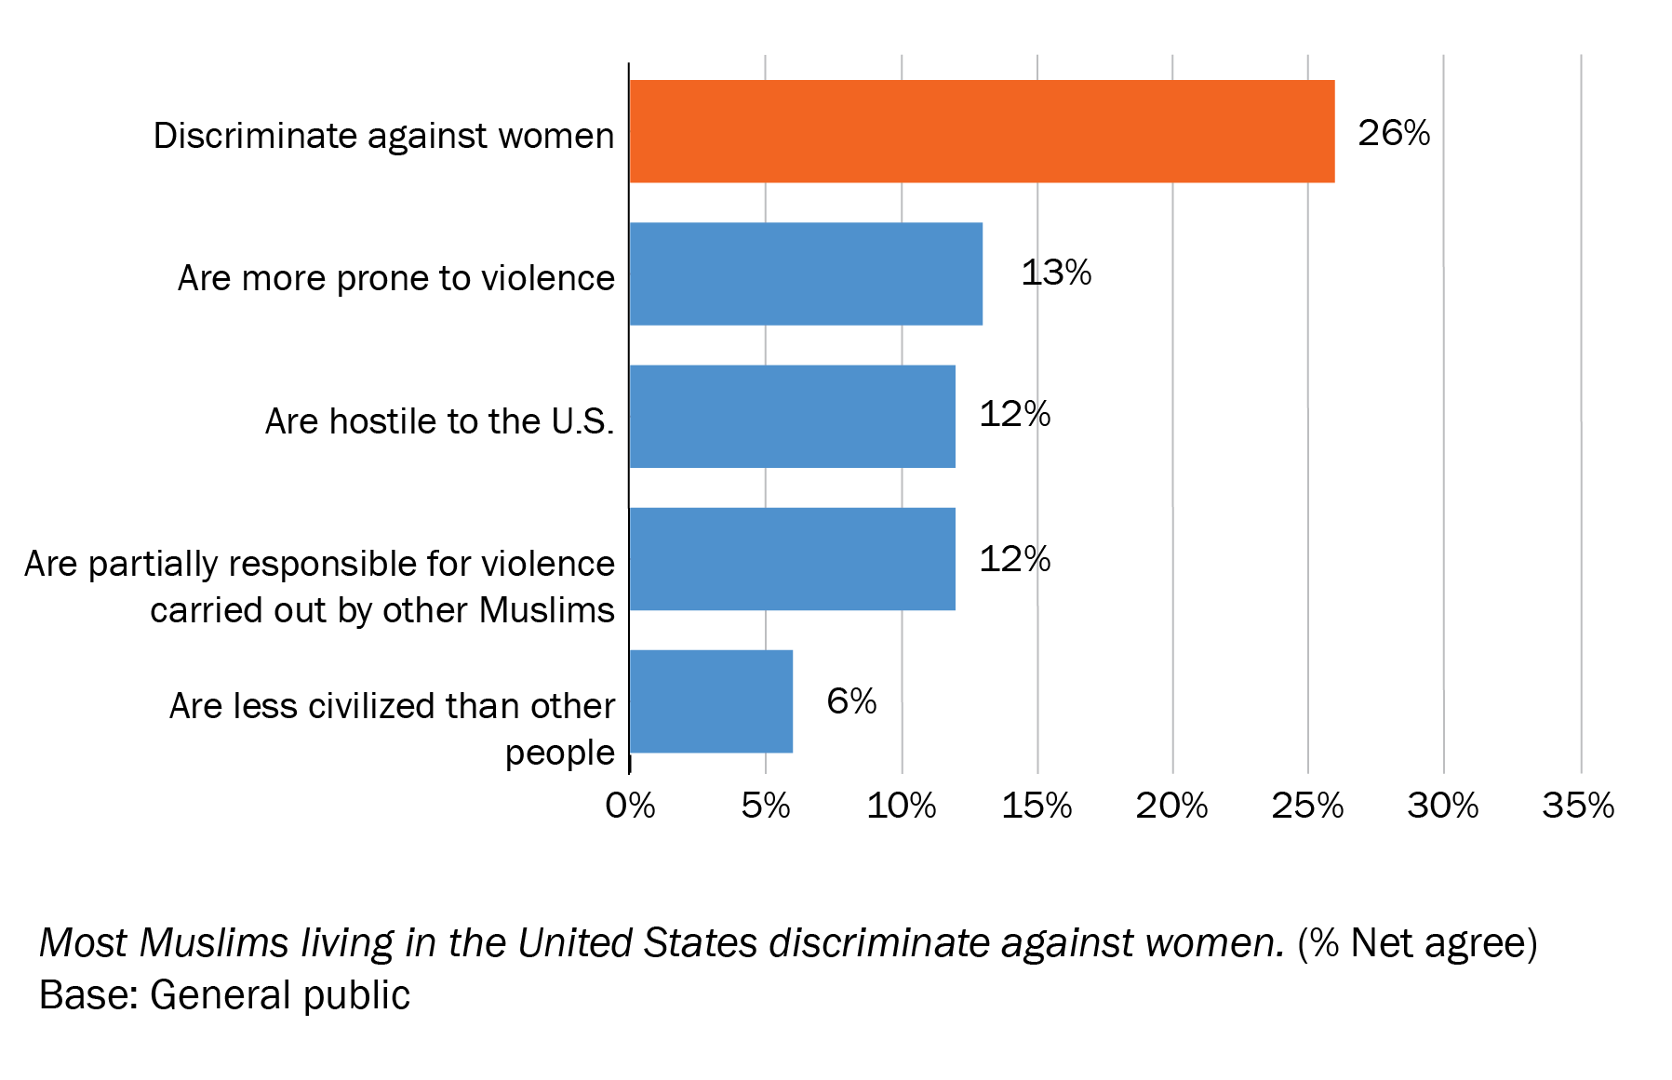
Most salient anti-Muslim stereotype among general public is misogyny
Notes:
One of the most common tropes about Muslims concerns misogyny. Let’s look at the facts.

Slide 47
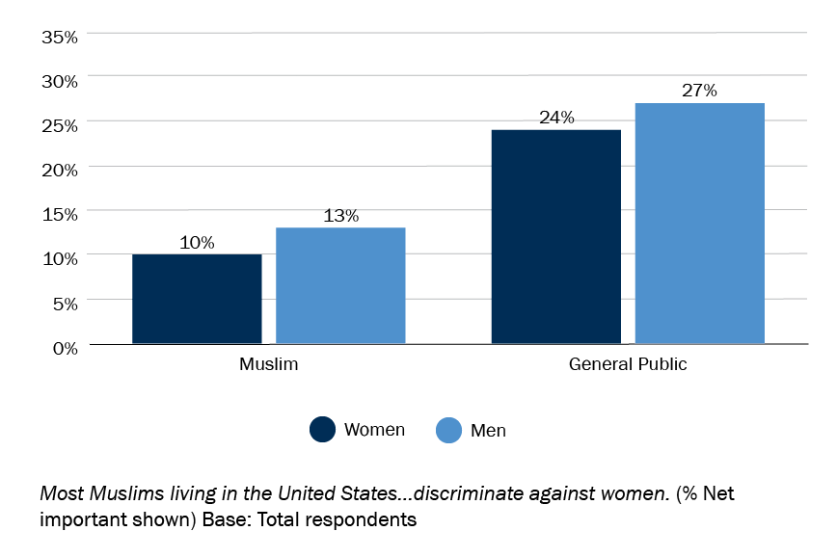
Muslims least likely to endorse “misogynist Muslim” stereotype
Notes:
Muslim women and men rarely say they think most Muslims discriminate against women.

Slide 48
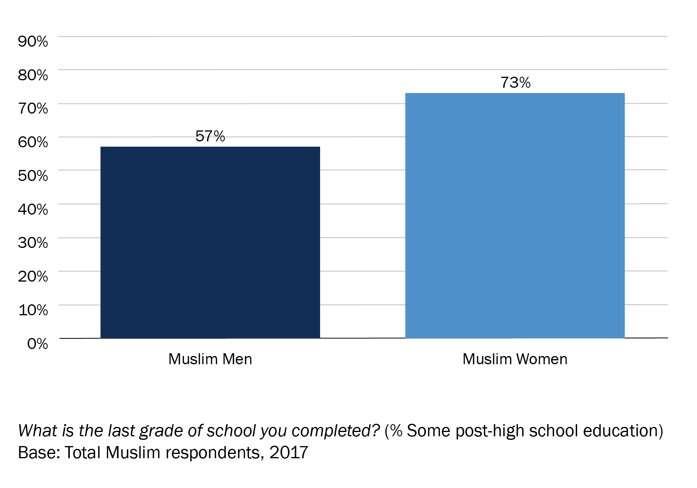
Muslim women surpass men in education
Notes:
Muslim women exceed men in level of education.

Slide 49
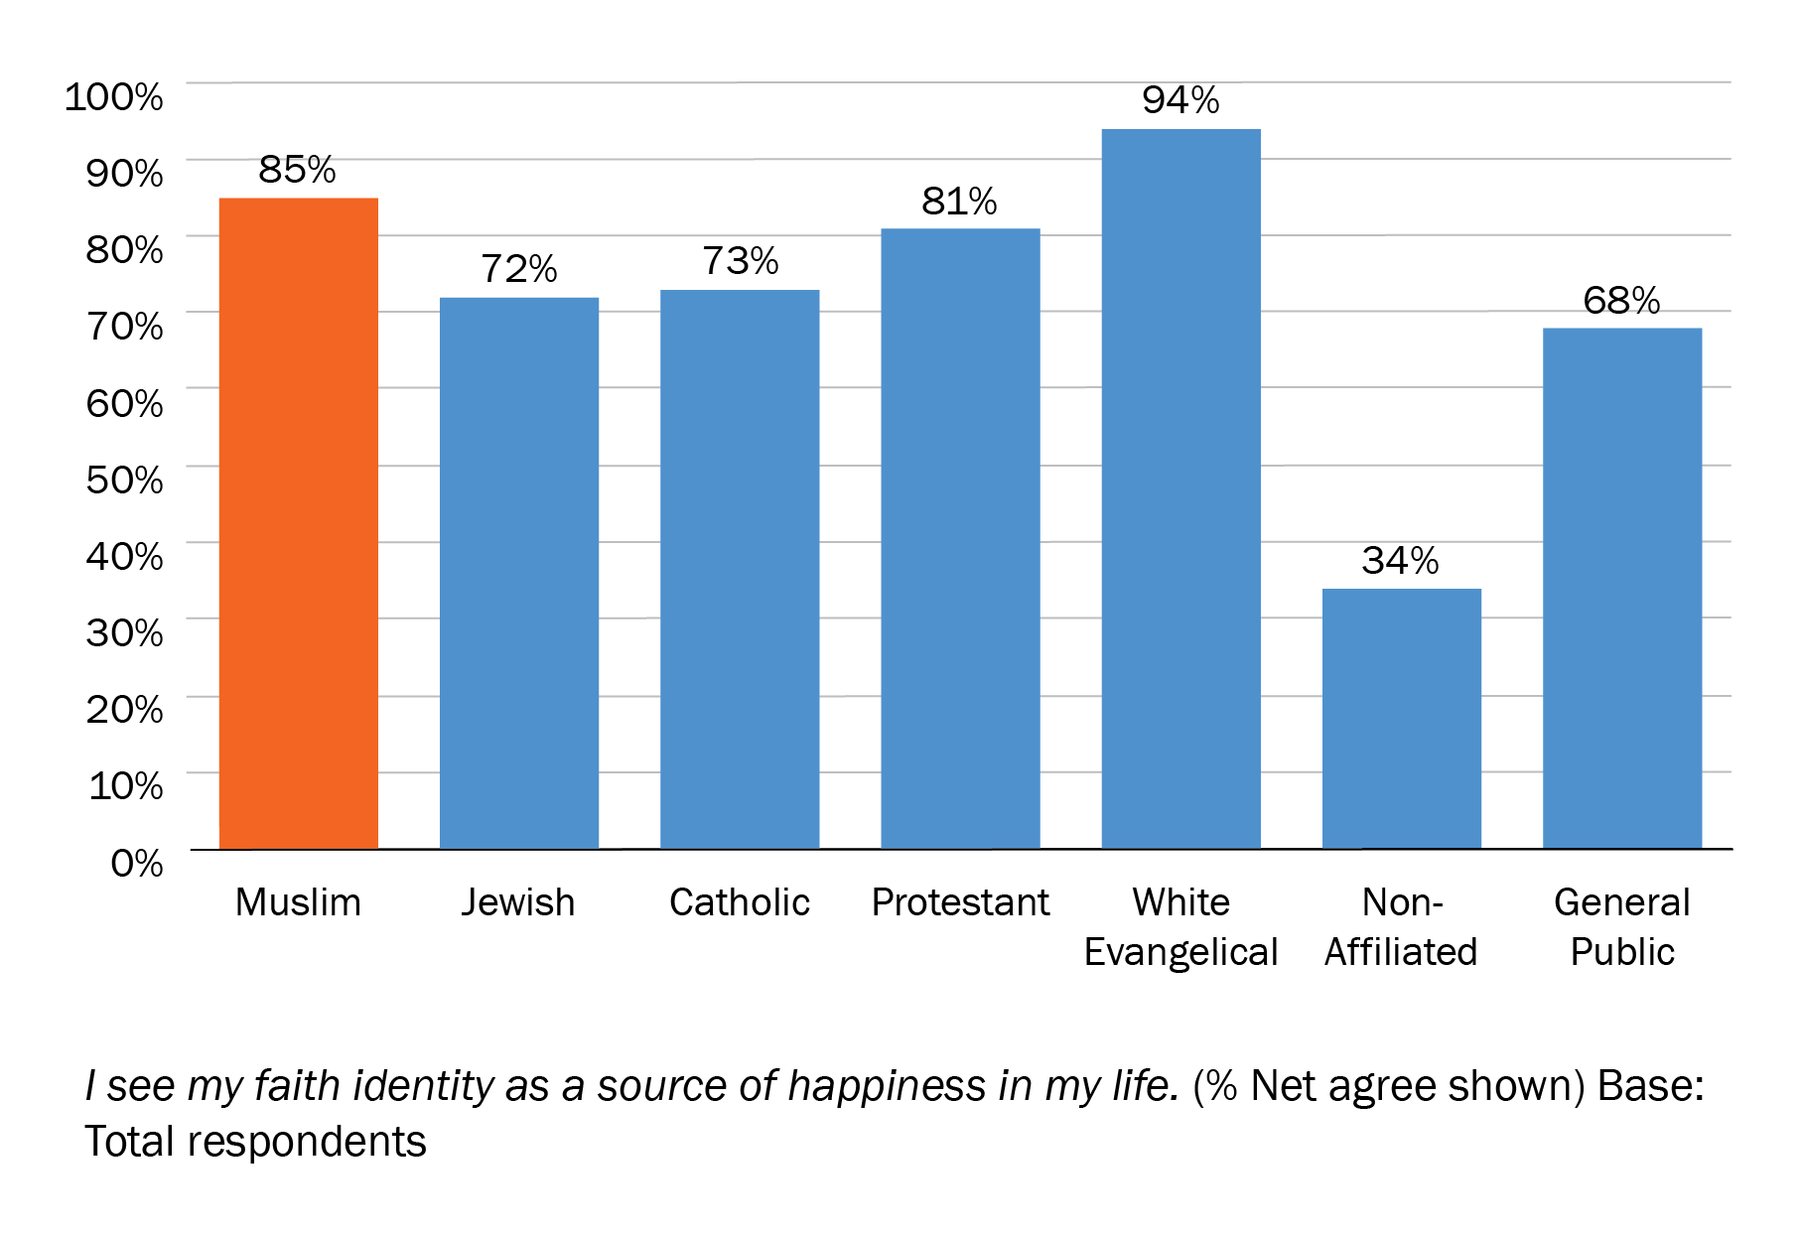
Muslims among most likely to say faith source of happiness
Notes:
Muslims in general, and women are no different than men, say their faith is a source of happiness in their lives.

Slide 50
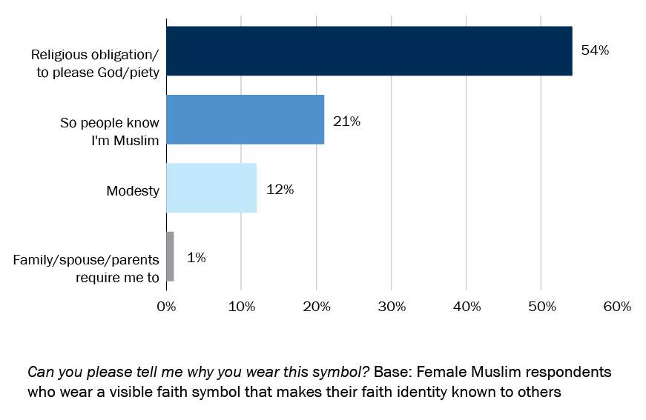
Piety, identity top reasons for hijab
Notes:
Muslim women who wear hijab say they do so for religious or identity reasons, and not because they are forced to by a family member.
% Who wear a religious symbol b/c spouse/family forces me to wear it:
Muslim 1%
Jew 8%
Catholic 2%
Protestant 1%
W. Evangelica 5%
Non-affiliated 0%
Jews and W. Evangelicals significantly higher than Muslims (and Protestants - Jews only)

Slide 51
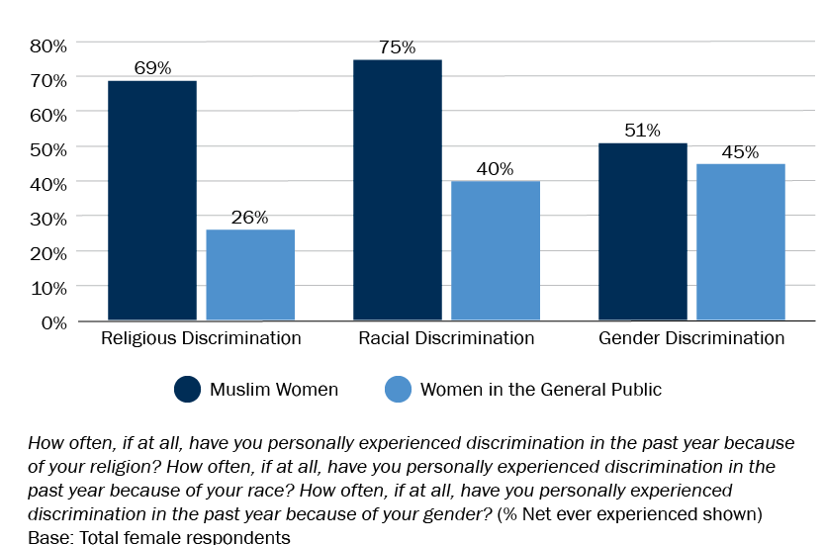
Muslim women experience more religious, racial discrimination but same level of gender discrimination as women in general public
Notes:
So do Muslim women face misogyny? Yes, of course many do!
But they are no more likely than another other women to. The facts show that Muslim women are as likely as any other women to experience gender discrimination.
However, they are far more likely to experience racism and religious discrimination. If folks want to save Muslim women, they should work to protect them from racism and islamophobia, not Islam.

Slide 52
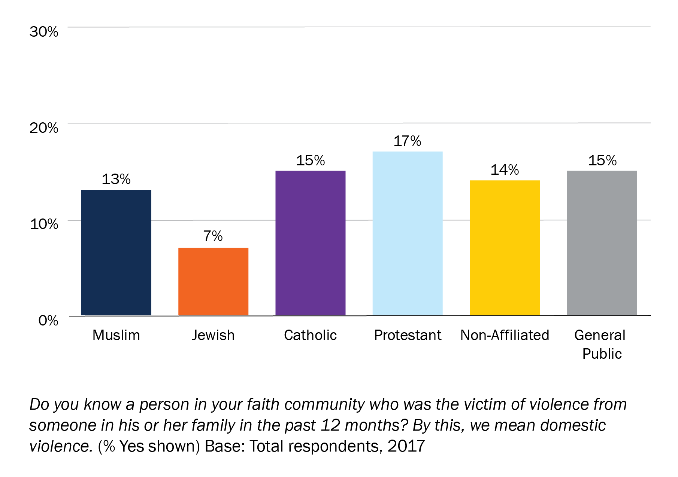
Domestic violence plagues most faith communities equally
Notes:
Domestic violence plagues almost all faith communities in America equally. In other words, misogyny is a human, not an exclusively Muslim problem.

Slide 53
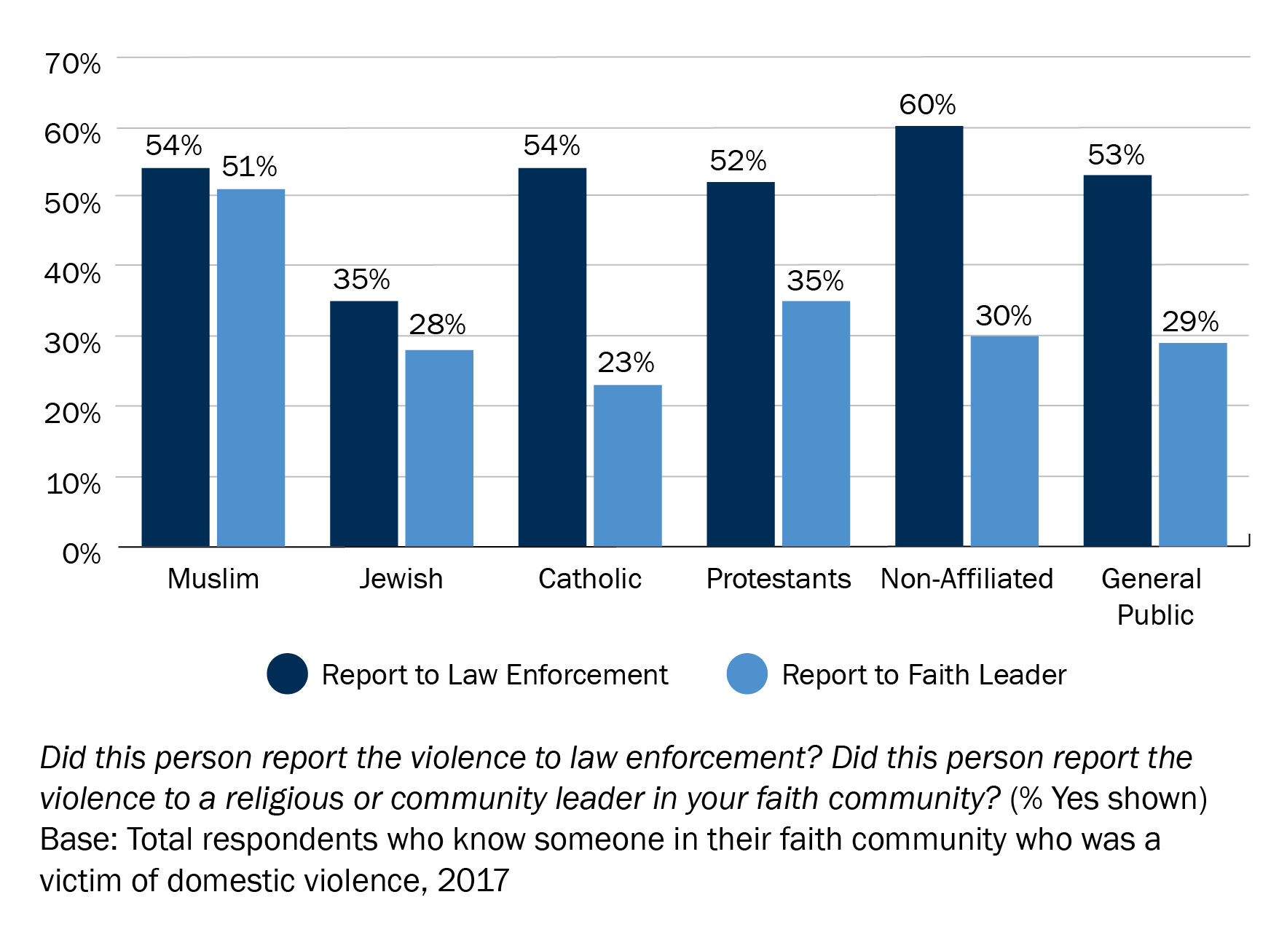
Muslims most likely to report domestic violence to faith leader
Notes:
What makes Muslims unique is the victims of domestic violence are the most likely to report it to a faith leader in addition to law enforcement, suggesting she expects to find support with faith leaders.

Slide 54
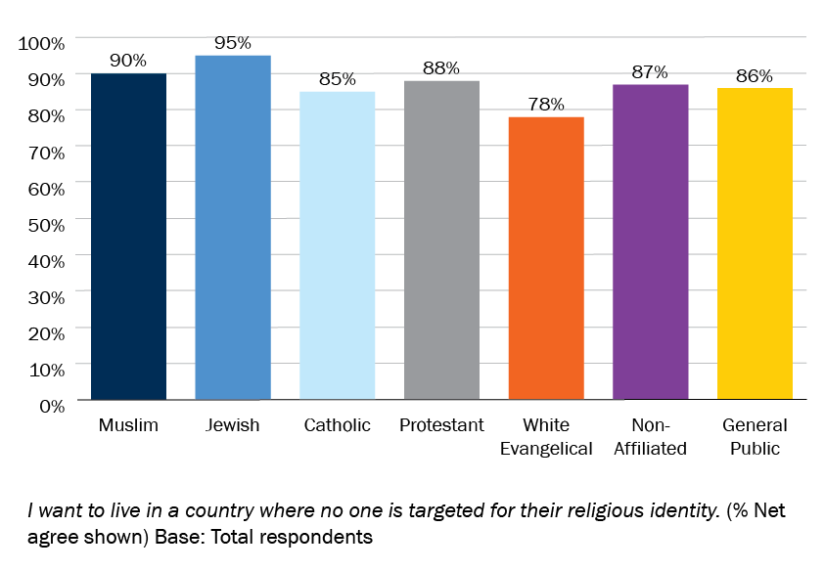
Most Americans want to live in a country where no one is targeted for their religious identity
Notes:
The reality is that most of us want to live in a country where no one is targeted for their religious identity. Here are some things you can do to make that a reality.

Slide 55

Hate Hurts All
When we are afraid we are more likely to accept:
Prejudice
Conformity
Authoritarianism
Fear kills freedom.
Notes:
Islamophobia is about fear and when we are afraid, according to neuroscience research, we are not only more likely to be bias toward people who are different from us, but we are more likely to accept conformity and authoritarianism. Fear kills freedom.

Slide 56
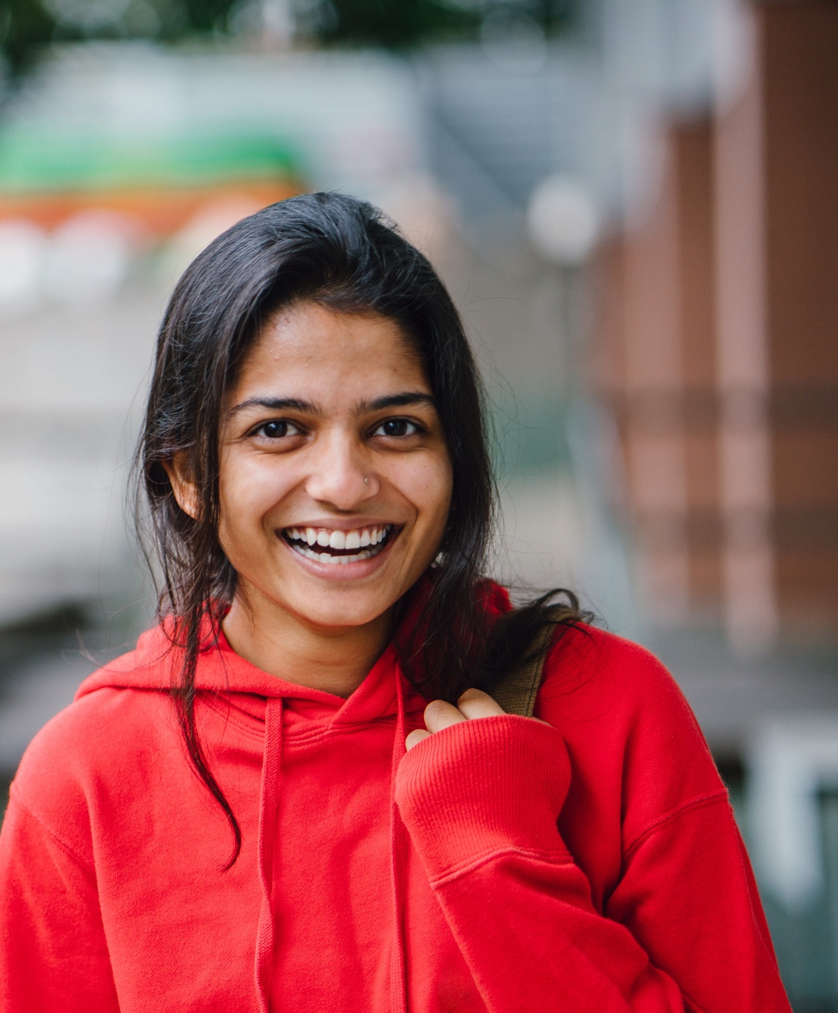
Stronger Together
Be an ambassador for the facts
Be an informed media consumer
Speak up
Participate
More information at www.ispu.org
Notes:
So what can we do? We can tell our friends what we learned here. We can consume media with a critical and informed mindset when hearing negative stories about any marginalized group. We can speak up when we hear rhetoric that hurts our country and contradicts the facts. And we can participate by voting and volunteering and working in coalitions to bring about the nation we all deserve.
Thank you

Slide 57
Questions & Answers

Slide 58

Muslims, public split on Muslim need to condemn terrorism
Notes:
If responding to a question about the need to “condemn terrorism” you can show this slide to show that the public is split on this question, even Muslims are. Then go on to explain:
Muslims have repeatedly condemned terrorism in the name of Islam
The reason many don’t feel this kind of condemnation is necessary however is that opposition to the killing of innocent people should be assumed. Human decency is assumed of others who have members of their group do terrible things in the name of that group. For example, the KKK, which carries out targeted violence against many communities, calls its self, not a hate group, but a “Christian organization.” https://www.huffpost.com/entry/virginia-kkk-fliers_n_5008647, However, white Christians are not suspected of condoning the KKK’s violence in the name of white Christianity unless and until they condemn it “loudly enough.” Muslims are expecting the same assumption of human decency. Fairness, not favors.

Slide 59

White Evangelicals most likely to say their religion should be a source of American law
Notes:
Can be used in Q&A if question about sharia comes up.
If you are concerned about religion entering our legal system, Muslims are the last group you should worry about.

Slide 60

U.S. Media Furthers Perception that Muslims Are Misogynistic
Study by Rochelle Terman (Stanford)
Data collected from 35 years of New York Times and Washington Post reporting
U.S. news coverage of women abroad is driven by confirmation bias.
Stories about Muslim women emphasize gender inequality, even for countries with relatively good records of women’s rights.
Notes:
Study by Rochelle Terman (Stanford)
Data collected from 35 years of New York Times and Washington Post reporting
US news coverage of women abroad is driven by confirmation bias
Journalists more likely to report on women living in Muslim and Middle Eastern countries if their rights are violated, but report on women in other societies when their rights are respected.
Stories about Muslim women emphasize the theme of women’s rights violations and gender inequality, even for countries with relatively good records of women’s rights.
Full study
Washington Post article

Slide 61

Even if the nations rank more or less equally on the women’s rights index, women in Muslim countries are shown suffering misogyny, while women in Western countries are portrayed in more complex ways.
Rochelle Terman
Notes:
Quoted from Rochelle Terman’s Washington Post article

Slide 62
Feedback
Your feedback is important.
Please take this 3 question survey:
**Link is case-sensitive**

